Slide 1
Beyond Words- Hearing Every Voice
Personal Outcomes Network
Still Listening, Still Learning Series

Slide 2

Where We Started - Lanarkshire Day Service Self-Evaluation
Staff thought we were good at involving families and people who use words in evaluation but thought we could still do better in how we involved the people who do not use words in evaluating their service.
We rushed in to ‘fix it’ and provided lots of additional training in a range of assistive communication methods like talking mats, buttons, signifiers and Makaton etc.
That was fixing the wrong problem.

Slide 3
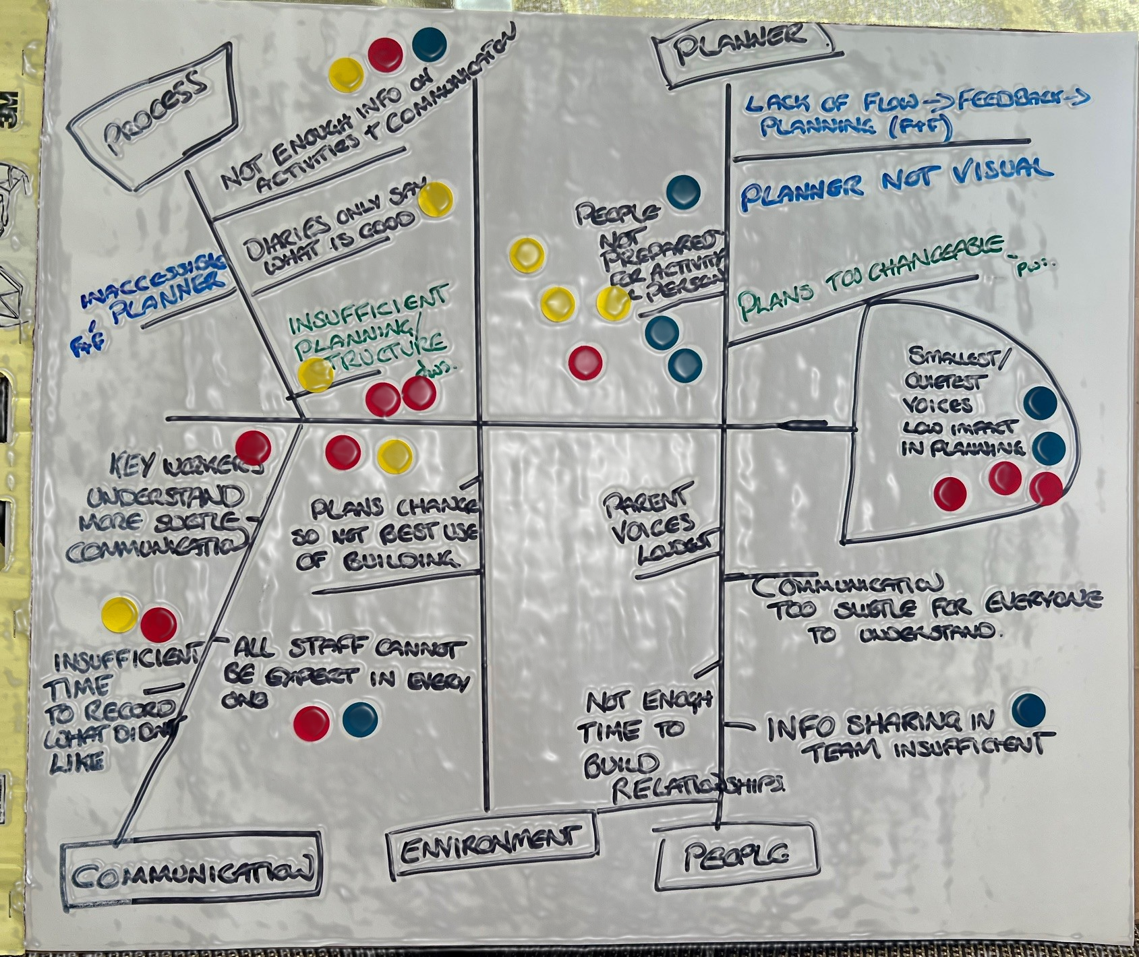
Fishbone Diagram
Key Findings
Evaluation for individuals can be quite binary
Asset based approach to recordings tends not to note ambivalence
Not all staff understand everyone’s communication

Slide 4
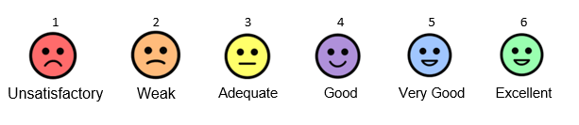
Rating scales
Rating scales for levels of engagement/interest and another for duration of engagement.

Slide 5
Interim Results
  More people completing their own recordings.
  Recordings are clearer for staff in terms of what they are recording and why.
  Staff report being more attentive to non-verbal communication
  More depth to our understanding of what is truly valued by individuals
  More systematic process for individual reviews and service evaluation so puts the people we support more firmly in the driving seat of their own service

Slide 6
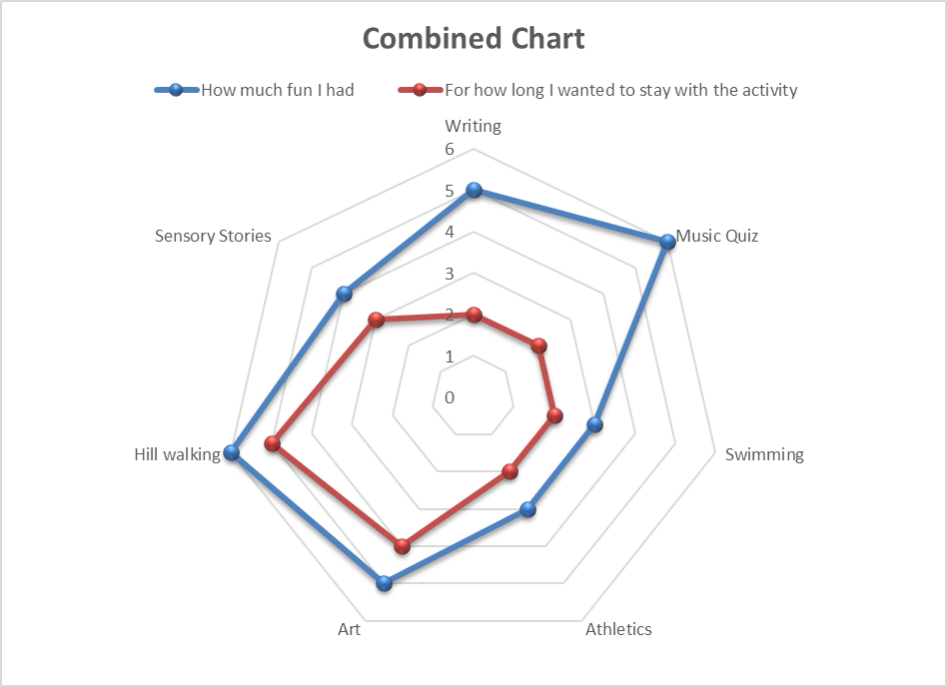
Example Results

Slide 7
Next Steps
  Build a digital solution to document the individual recordings and share them daily with families.
  Use this to automate the data to a useable format for reviews.
  Find a method to incorporate the impact relationships and social dynamics play on evaluations.
  Find a solution that can also make savings in labour costs and automate as much as possible.

