Slide 1
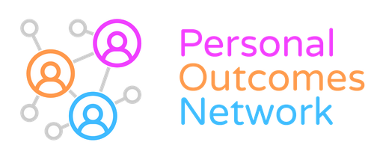
Recording personal outcomes
Stories from practice

Slide 2
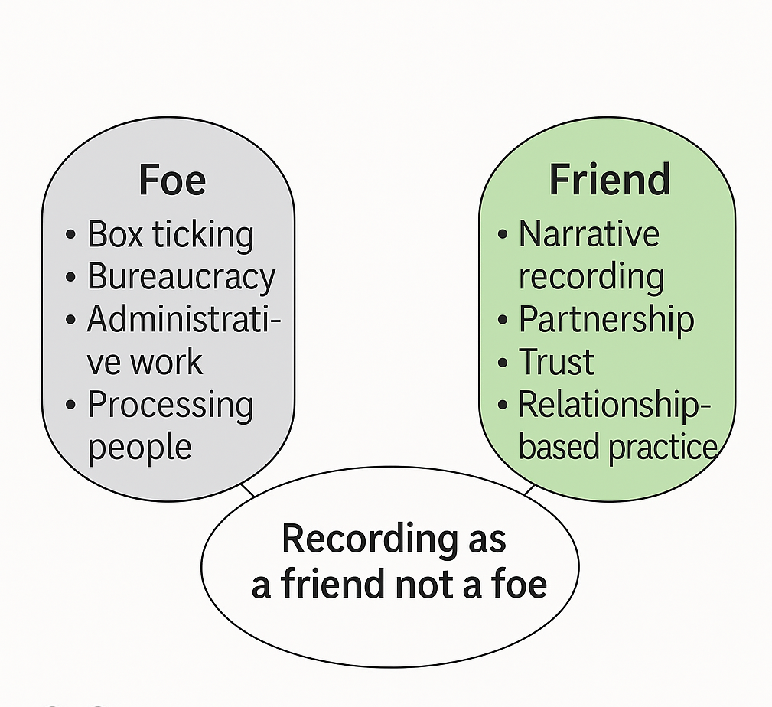
Background
Moving towards 20 years of personal outcomes collaboration
Lots of investment in good conversations – appropriately so
Recording needs attention in its own right
Recording as the bridge between conversations and decision-making
Not just bureaucracy – done well, strengthens relationships, decisions, morale
Outcomes as a measure of service or a driver for life? Compromise necessary

Slide 3
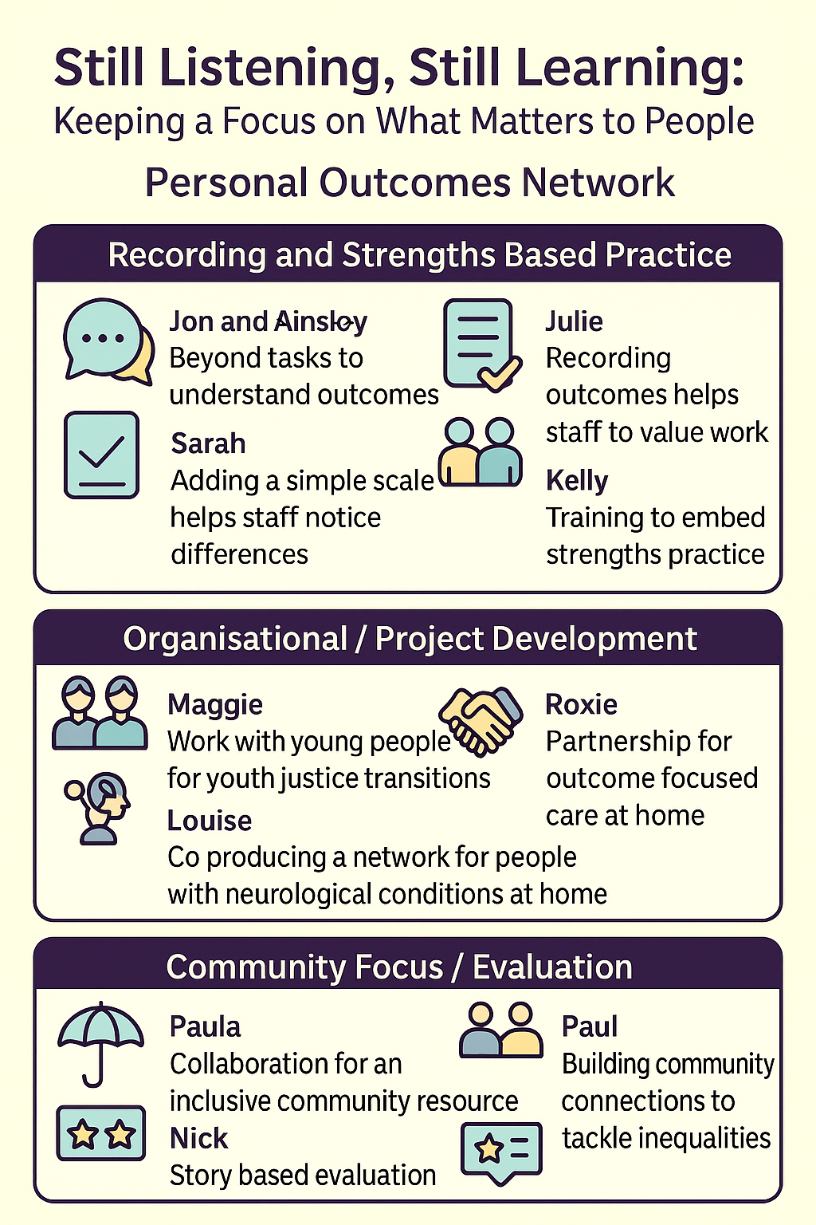
Today our focus is stories about practice
Previous covid story project
This year a continuation
Stories show the possible – new insights
June webinar – service improvement – outcomes
Second webinar from the stories – surprise to get 3 stories on this theme
Possible webinar 3 – communities, commissioning & outcomes

Slide 4
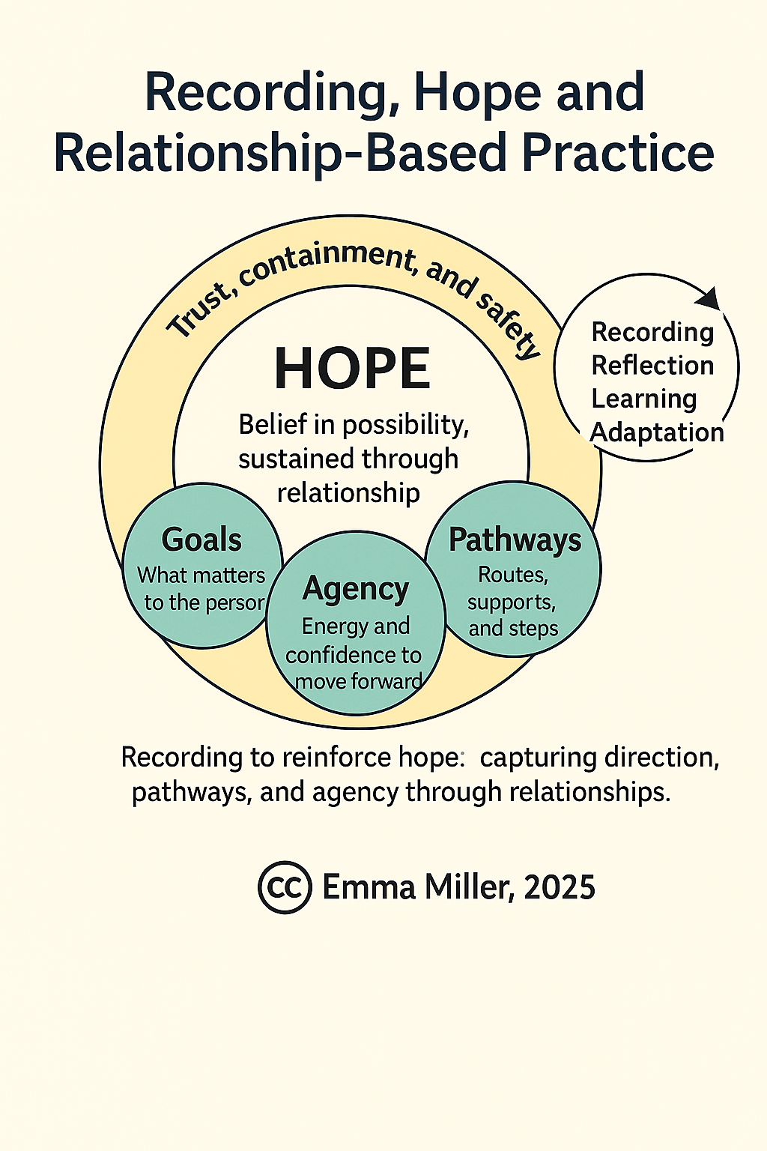
When we get recording right
Remembering Hope Theory (Snyder) is about goal setting – and defining pathways to achieving goals
Talking Hope project showed the importance of relationships in this – of trust and understanding
So when we are recording outcomes – hope (outcomes) becomes tangible – supports agency
Amplify strengths in the process
Relational aspects stand out in the stories

