Slide 1



Supporting carers: an outcomes focused approach
Laura Hill
VOCAL

Slide 2


Slide 3
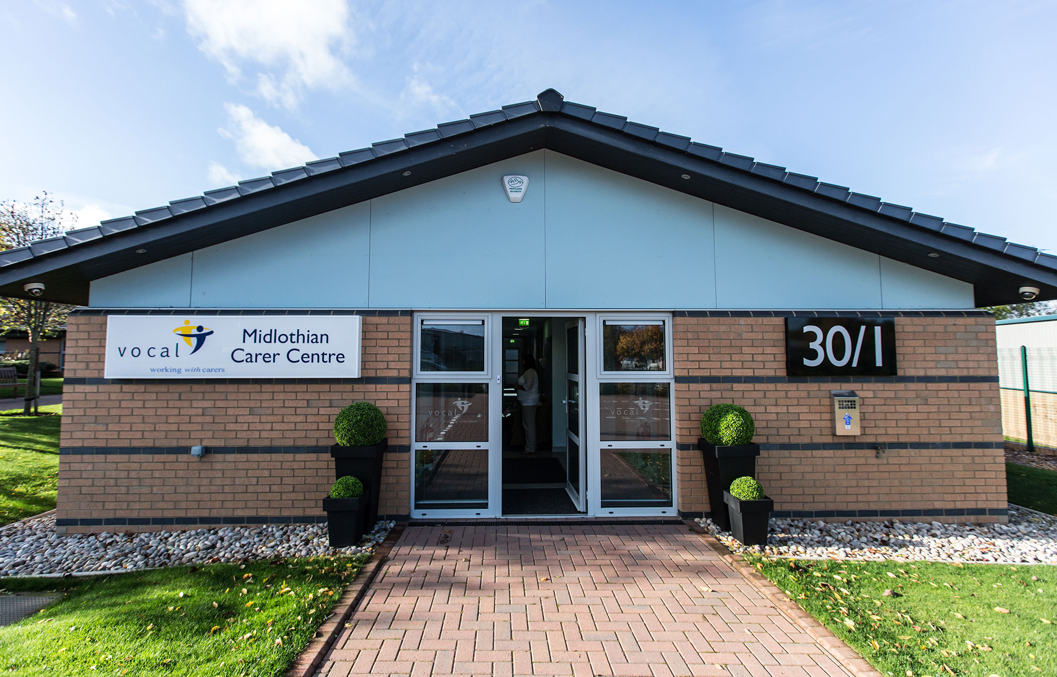

Slide 4
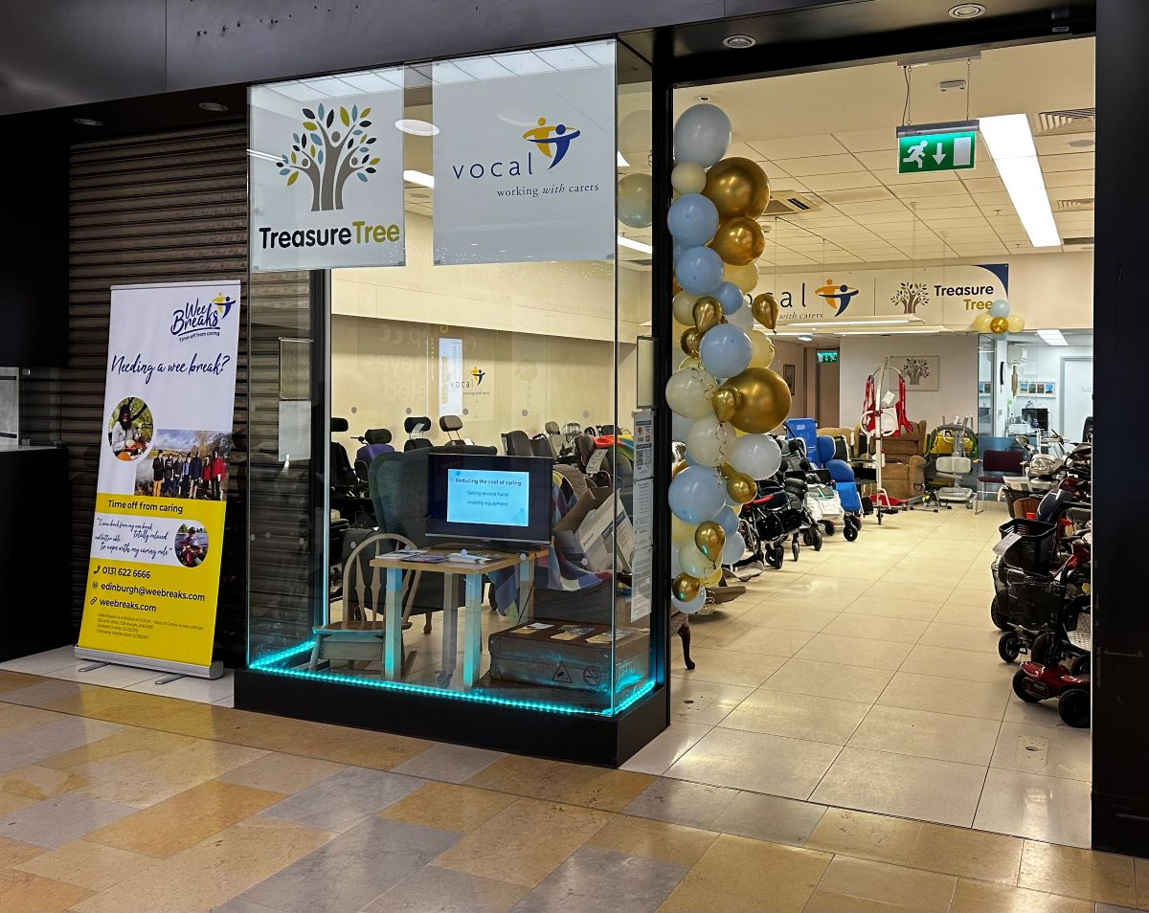

Slide 5
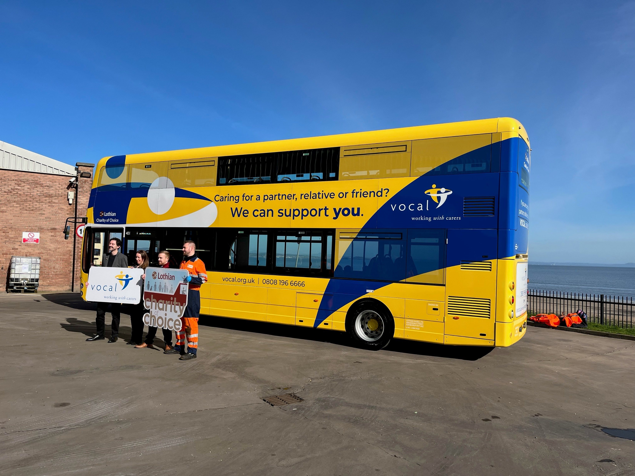

Slide 6

Good Conversations
Why is a good conversation important and
what difference can it make?

Slide 7
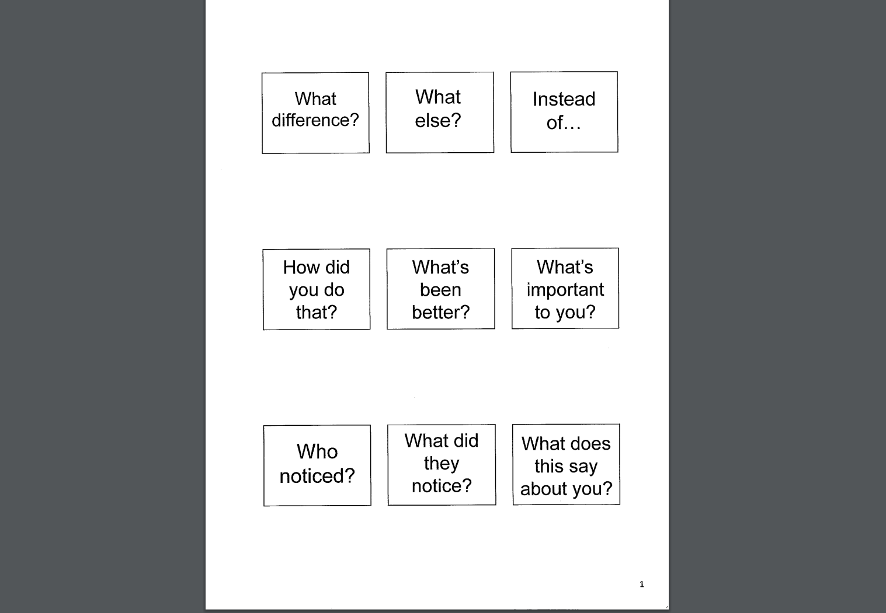
Solution focused questions

Slide 8
Adult Carer Support Plans
Adult Carer Support Plans
ACSP
  An ACSP helps carers to think about the support they might need as a carer, both now and in the future.
  It can also help the carer, as well as others they engage with, identify and better understand their support needs.
Notes:
The Carers Act introduced a duty to prepare an ACSP for anyone identified as a carer or for any carer who requests one.

Slide 9
Adult Carer Support Plans
Fundamentals of a good ACSP
Before a plan is started carers should be made aware of their right to an ACSP and have an opportunity to ask any questions.
It should be personal and reflect their unique situation, including quotes and examples.
It should capture the outcomes they want to achieve, and the support they need from others to help them meet these outcomes.
It is a living document which can be updated and reviewed as the caring situation progresses.
It should include clear actions, detailing who is responsible and have timeframes
It should also capture unmet need

Slide 10


Slide 11
Adult Carer Support Plans
Brokering support
Our Practitioners will work with carers to identify supports and solutions to meet their personal outcomes
This can include VOCAL services such as:
Wee Breaks
Counselling
Training and peer support
It can also include a range of community supports and services for the carer and cared-for person
It may also include statutory support and replacement care, such as respite

Slide 12
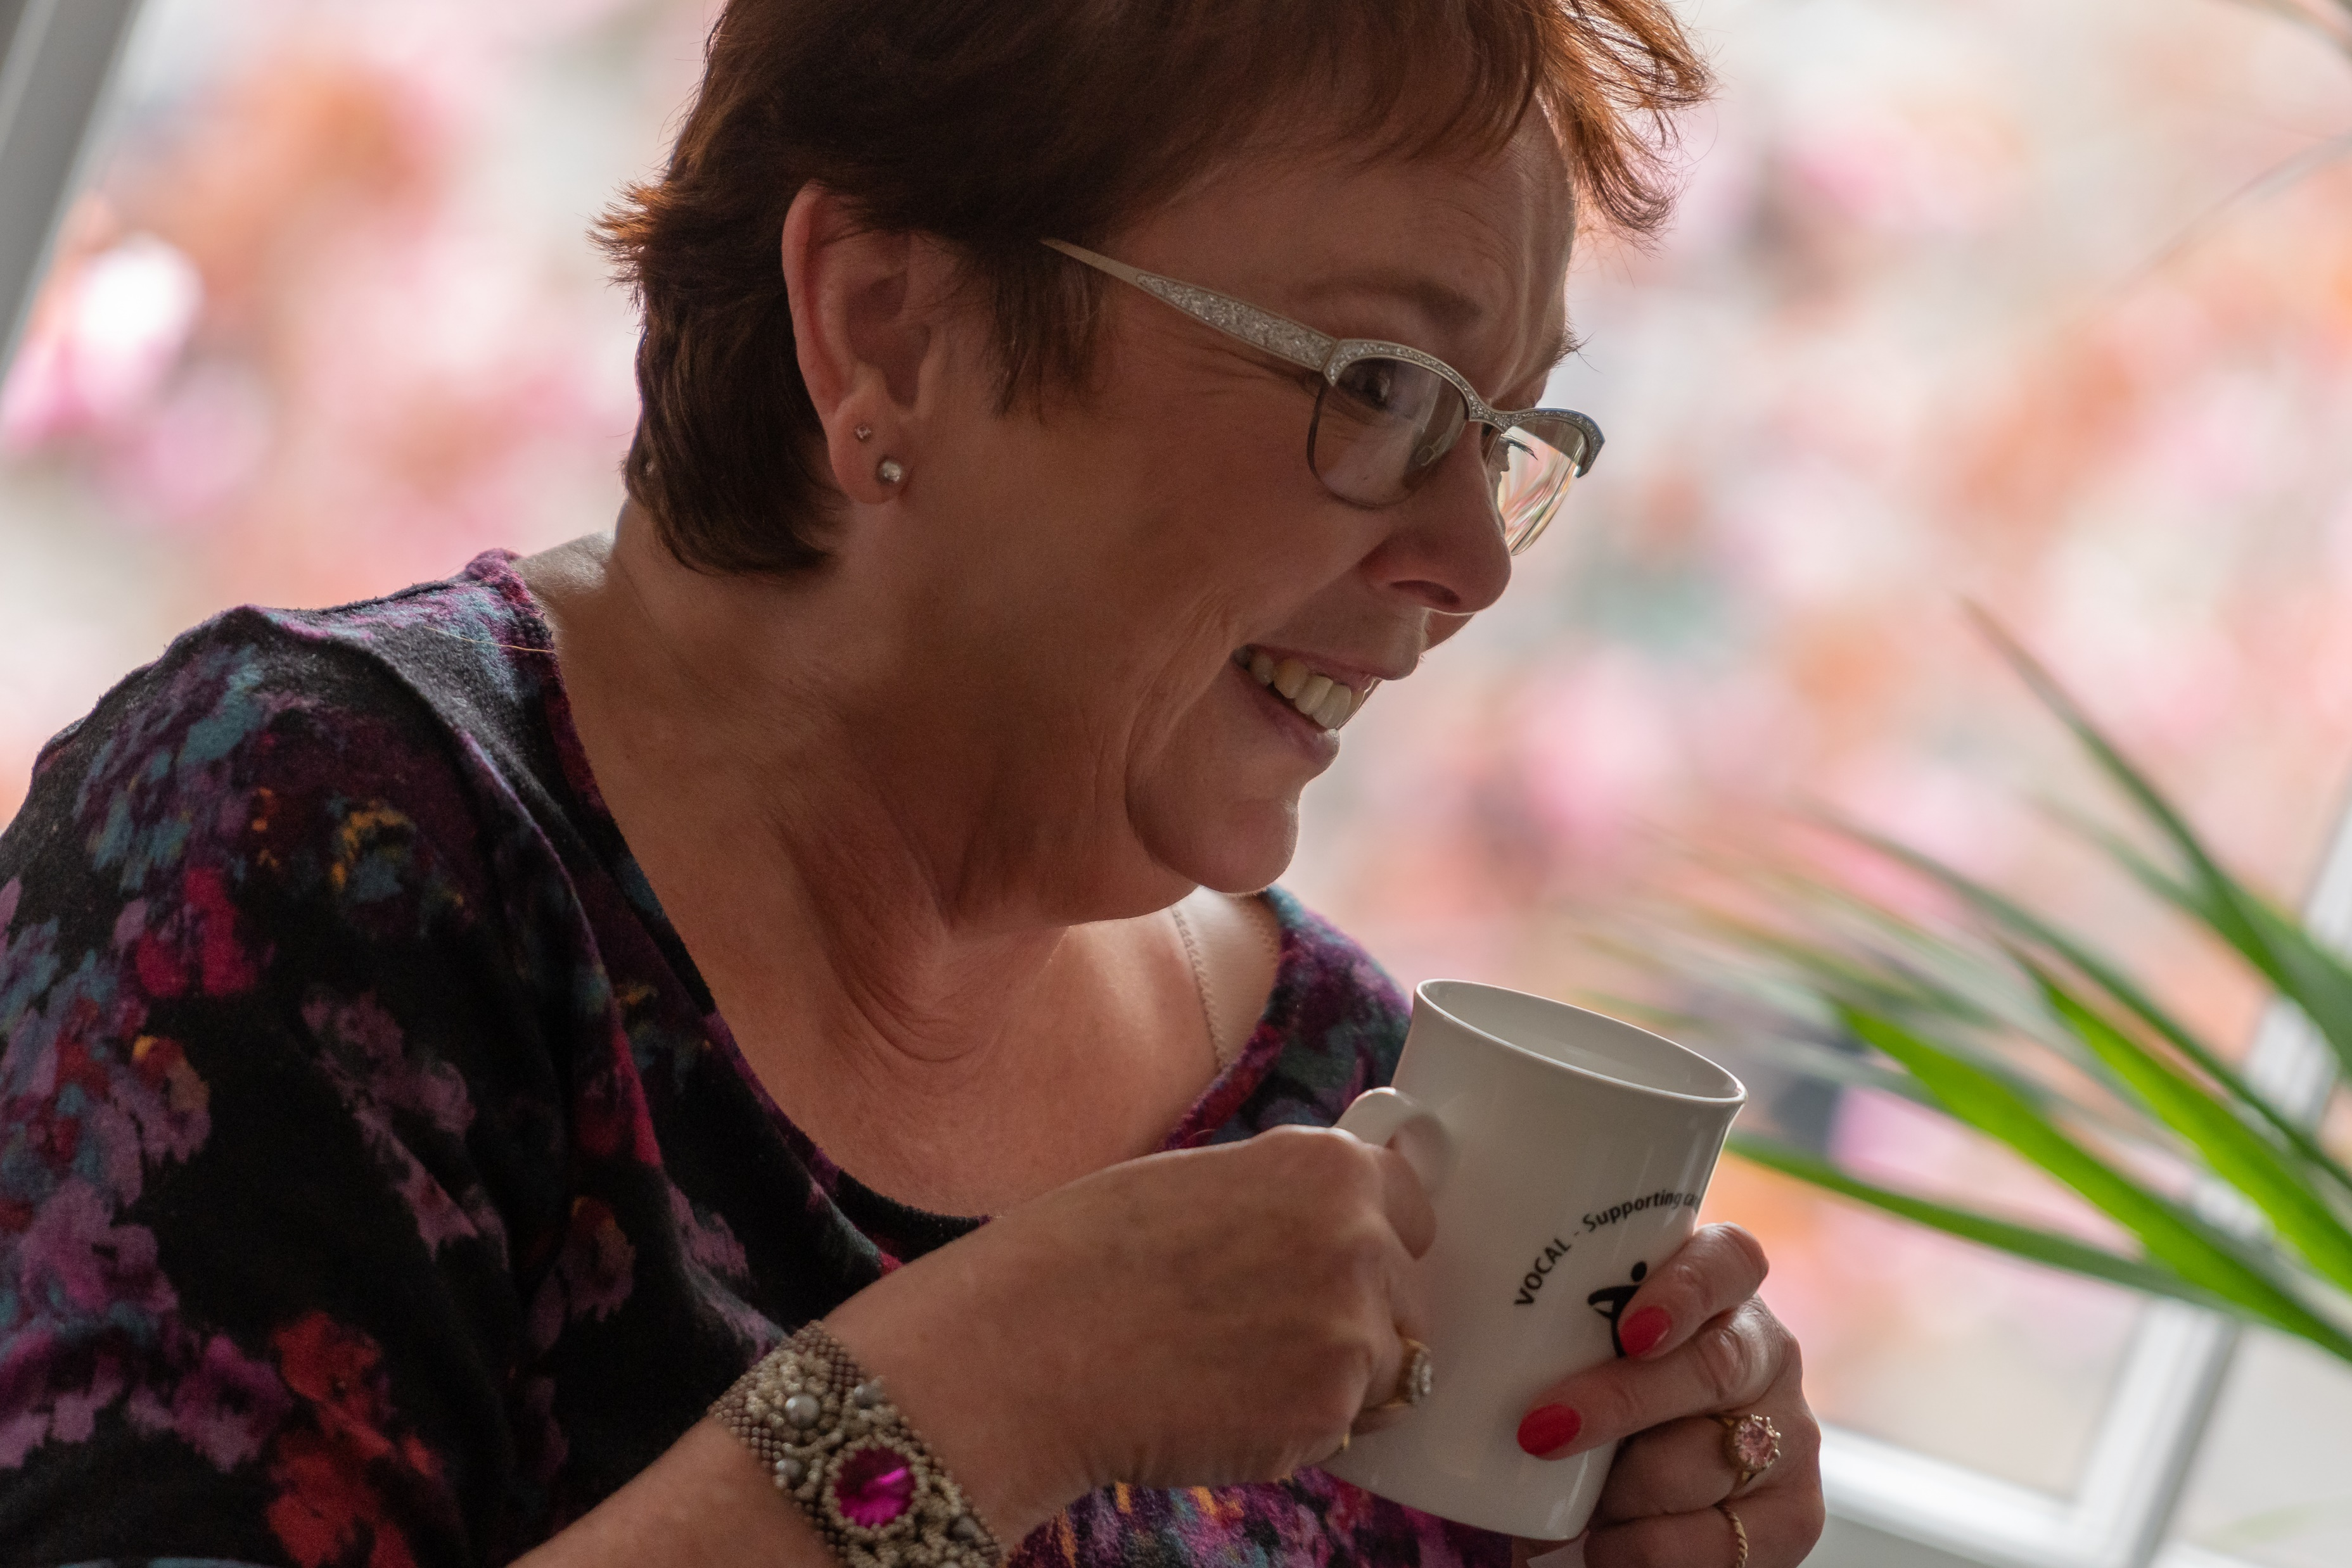

Slide 13
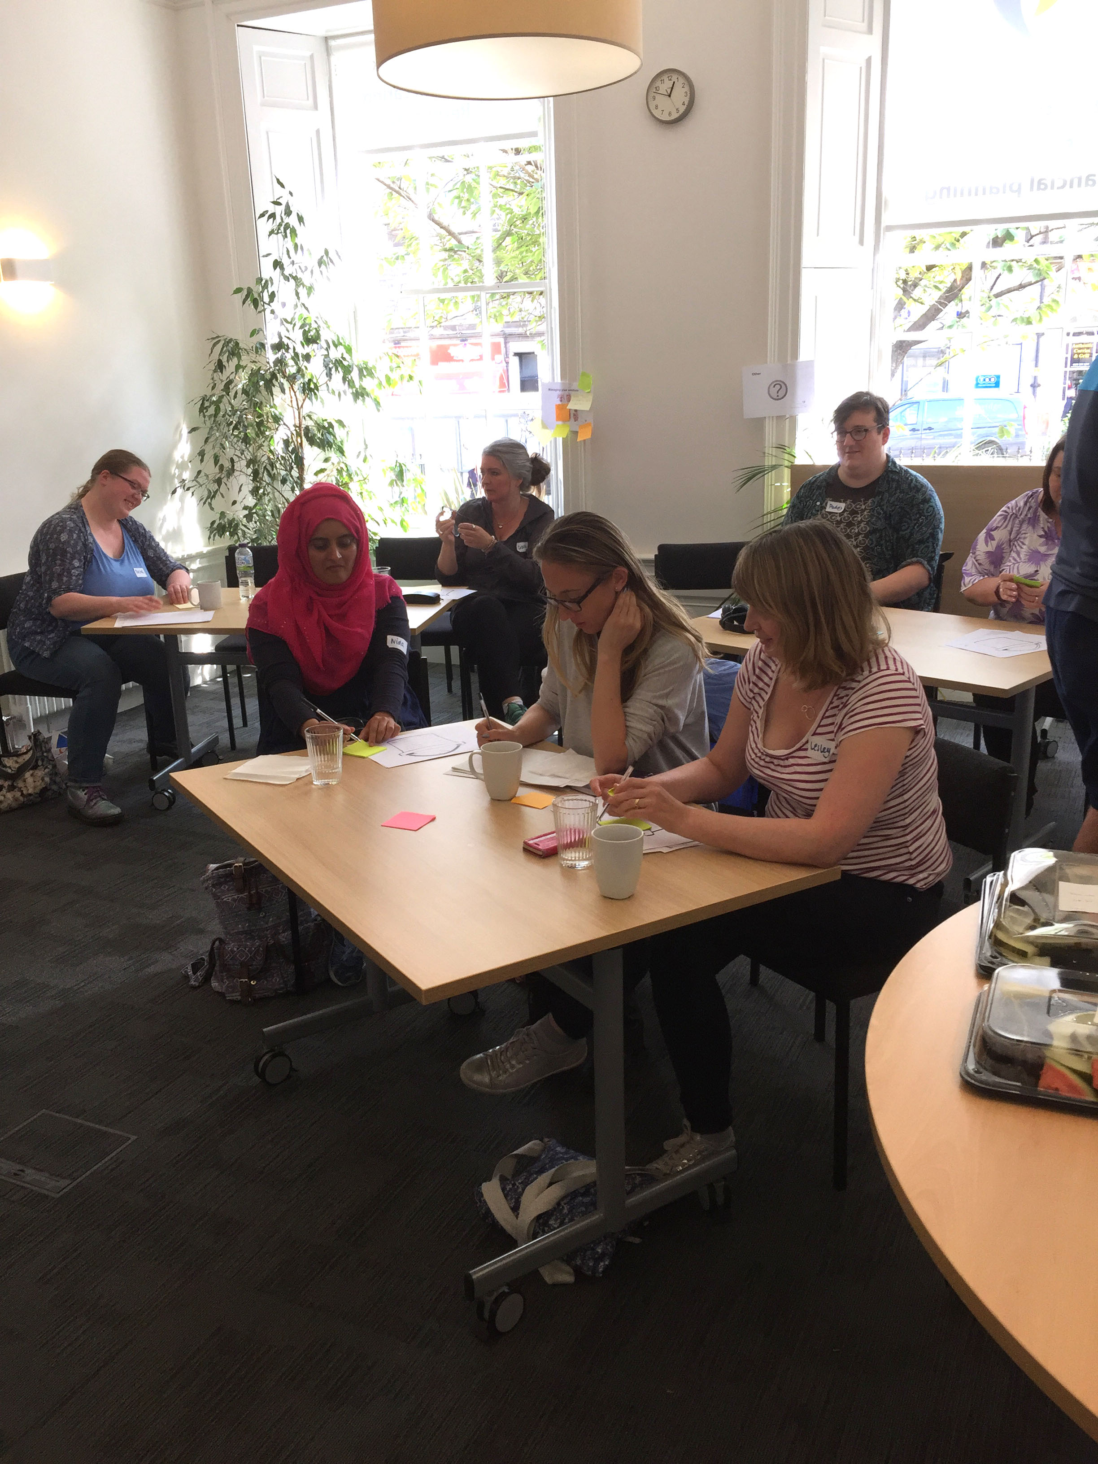

Slide 14
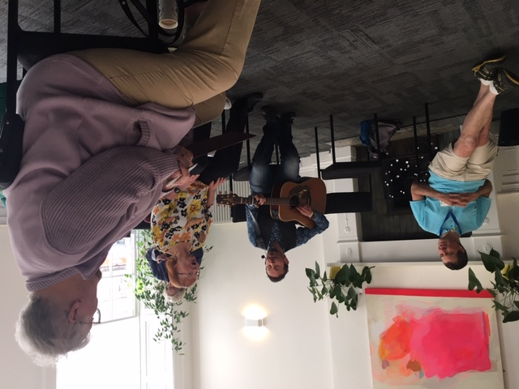

Slide 15
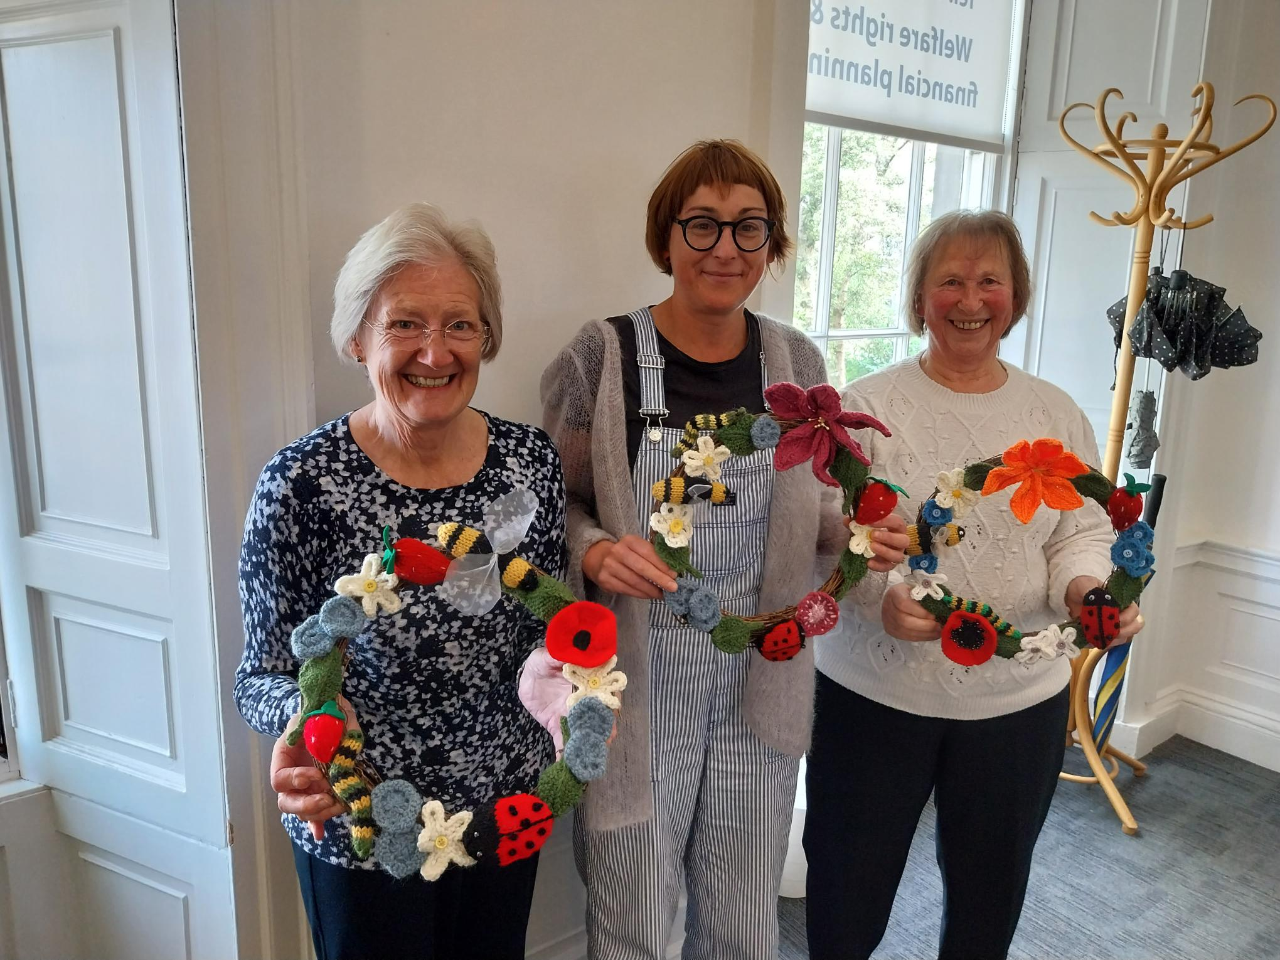

Slide 16


Slide 17
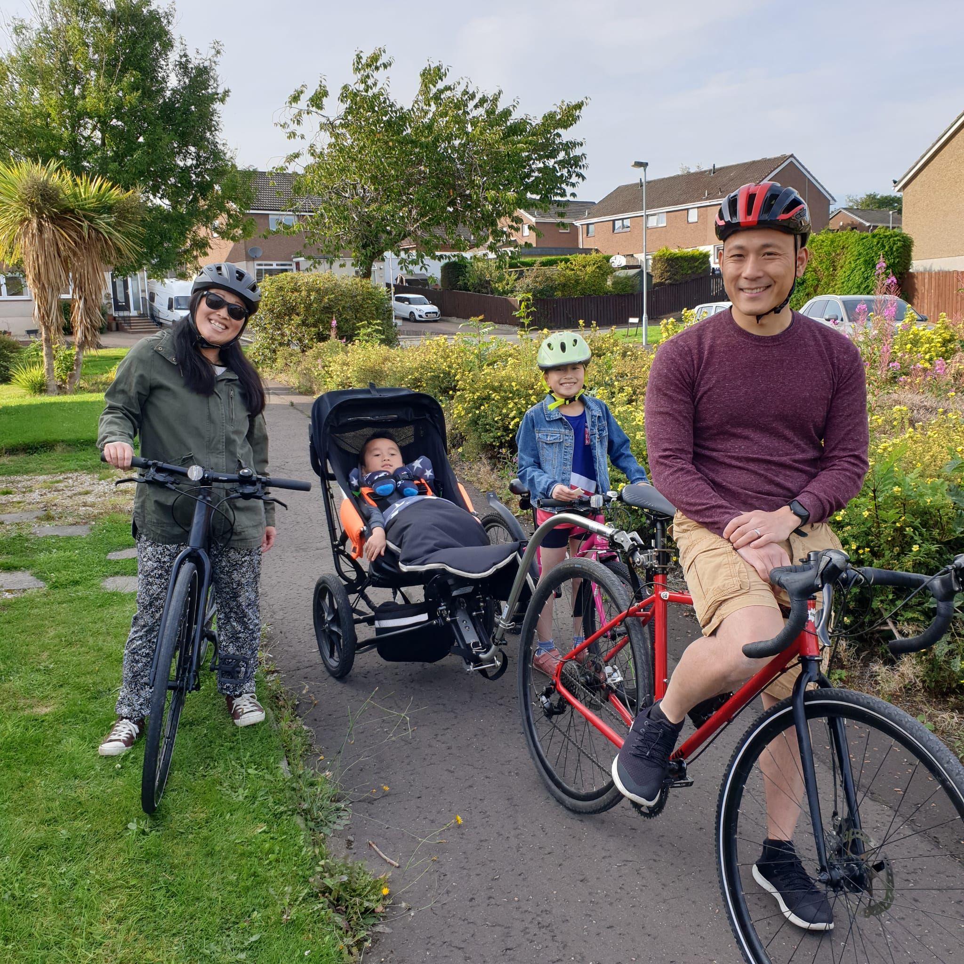

Slide 18
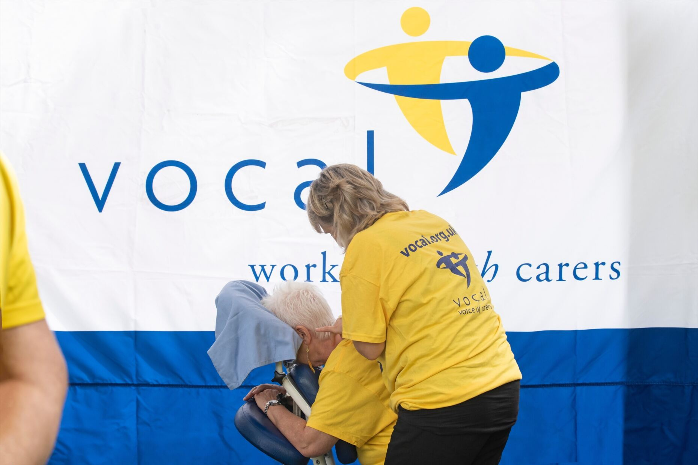

Slide 19
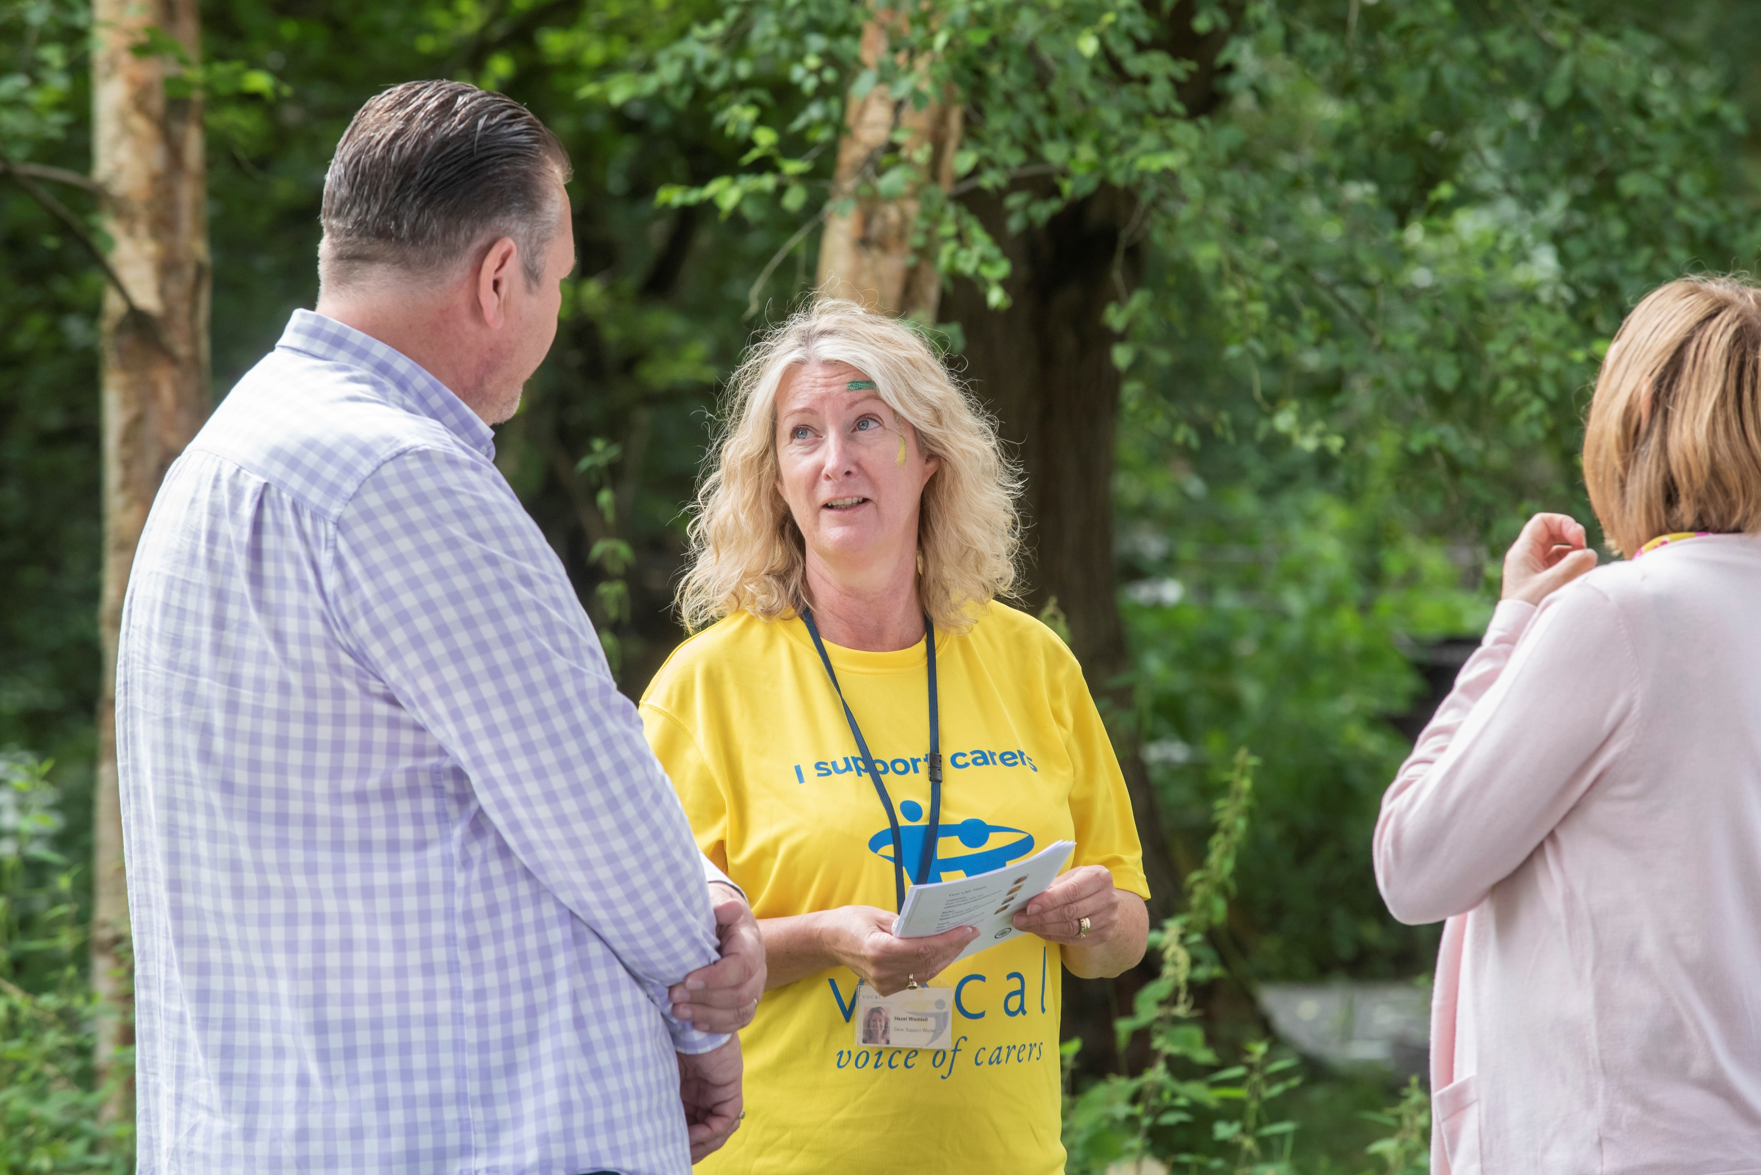

Slide 20
Adult Carer Support Plans
Care Cooperative
Midlothian Care and Support Co-operative will provide a platform that facilitates brokerage of personalised support for carers, identifies local assets, and enhances local economic value
Maximising local capacity:
Local assets and community resources
Existing services (this may include PA and PA recruitment opportunities)
Professionals/therapists – such as Podiatrists or Opticians
Handyperson/trades

Slide 21
Adult Carer Support Plans
Thank you!
Laura Hill
Head of Carer Services
lhill@vocal.org.uk

