Slide 1
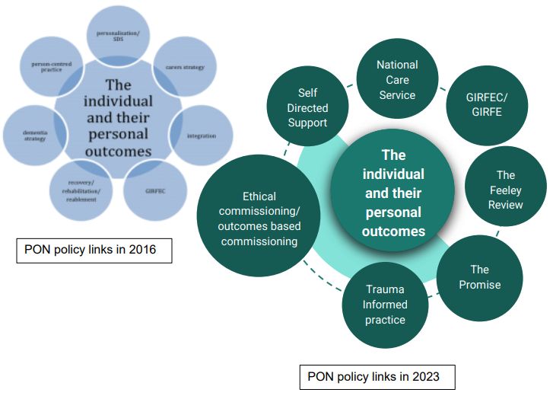
“Links to other networks (NHS What matters to you, HIS person-centred network) to leverage a collective voice in Scotland.”
– Strategic recommendation PON evaluation 2023
How might we establish a collective voice?

Slide 2
Person-centred approaches/ resources
Personal Outcomes Approach
Values Based Health and Care & Realistic Medicine
What matters to you?
Self-Directed Support (SDS)
Shared Decision Making
HIS Person-Centred Care Network – Improvement Plan for person-centred practice
Scottish Social Services Council - Personal outcomes, person-centred working and personalisation
HIS Person-centred literature review

Slide 3
Key Learning - Differences
Since person-centred care is an umbrella term for diverse approaches which are context dependent - it can be defined in different ways (HIS 2021)
The language used can still create tension/confusion (e.g. PC care/planning/approach/ service development)
Range of person-centred initiatives can feel overwhelming.
While each approach included relationship-based emphases, alternative understandings of each placed more emphasis on standardisation and measurement (relational v managerial) (SSSC 2018)

Slide 4
Covid Recovery: learning from person-centred approaches
In recent years in Scotland, there has been an increase in the number of policies described as 'person-centred'. However, there is no common definition or shared understanding of what the term means.
From the literature and case studies examined in this paper, four key attributes essential to person-centred approaches were identified. These attributes are:
  Holistic – starting from an understanding of the person and their needs
  Ethical – adhering to a set of strong ethical principles
  Assets based – building on the strengths of the person and their informal networks
  Relational – recognising the importance of building relationships and trust
Covid Recovery: Learning from person-centred approaches Scottish Government 2023

Slide 5
Key Learning - Similarities
Engage with the person / family in the context of their whole life (holistic)
Engage in knowledge exchange, rather than professionals imparting knowledge (relational, ethical)
Acknowledge and build on people’s strengths and capacities (strengths/assets based)
Build connections to community and not just services (SG report also references community centred)
SSSC, December 2018 / SG OCSPA Learning from PC approaches 2023

Slide 6
What’s unique about the personal outcomes approach?
A personal outcomes approach makes some elements more explicit:
More explicitly about the whole person (e.g. Talking Points outcomes includes diverse QoL and change outcomes)
What matters to you in the context of your life? Not just in service land; - Shifts focus from outputs to outcomes (cake diagram)
Also includes process outcomes – being listened to, respected, valued etc. (relational aspects)
It is a whole system approach – intended to be embedded across the organization, at different levels
Exchange model emphasis on everyone’s contribution
Recording criteria help to crystalise this (outcomes not just outputs – personalized – person’s voice – person/family’s role – action oriented)

Slide 7
Story time…
Listen to the following story and note:
Where does the approach shift to personal outcomes?
What difference does this make to the person and practitioner?

Slide 8
I was working with one lady with Parkinson’s disease who had been referred to the service by the Parkinson’s nurse to work on her outdoor mobility and confidence in walking. She had no family apart from a cousin who was doing her shopping for her. Balance was the main problem, which was affecting her independence and ability to get out and about. After a few visits there had been very little improvement in her balance. We had identified that getting back to the local shops was something to work towards, but as time went by, this seemed more unlikely. I was starting to think about taxi cards, but because of the SHINE project I was able to stick with it a big longer.

Slide 9
I accompanied her out on an attempted trip to see how far she could go. She didn’t get very far at all as lots of people were stopping her in the street and speaking to her. She seemed to know everybody and just lit up. She didn’t get as far as the shops, but I realised that wasn’t that important to her. It was literally ‘’getting out and about,” seeing people, being part of the community again. That was what was really important to her and taking a taxi to the shops wasn’t going to help with that.

Slide 10
So we started thinking not so much about getting to the shops, but just getting out and about and what that would mean to her. Then, with a little more time and a bit more input, her confidence came back and she suddenly started to improve. She has a three wheeled walker and is now using that on her own to walk to the doctor’s surgery and library, which are quite close by. Her cousin is also sometimes doing the shopping for her and sometimes with her, depending on how she feels, but doing the shopping is not a big issue. She also visits a friend in a nearby care home. She is able to walk there, but not back, so she’s made arrangements with the friend’s family to let them know when she’s going and they’ll come and take her back home.

Slide 11

Coffee Break

Slide 12
Table Discussion
What similarities and differences exist between an outcomes approach and other person-centred initiatives?
What difference does focusing on outcomes make?

