Slide 1
East Ayrshire Alcohol and Drugs Partnership (ADP)
Notes:
Welcome to presentation on the ADP and the work we do in East Ayrshire to support individual outcomes
Our work is of a multi agency partner format and we work across a ROSC Partnership (Recovery Orientated System of Care) working together across all sectors that support individuals, families and communities touched by alcohol and drug use. We lead and set up of groups that drive and create partner led action plans across EA we also commission services across all mediums with SG and EA Council monies all this work is governed and scrutinised across all levels from top to bottom and back up again. Our role within the ADP is strategic in nature and we work alongside other strategic and operational partners as well as community members to create a trickle down trickle up partnership style of working. We are the middle man between Scottish Government and local services and supports in EA.

Slide 2
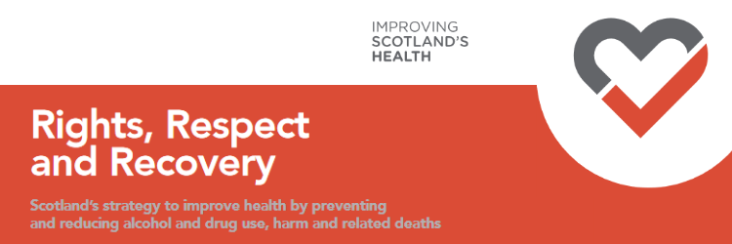
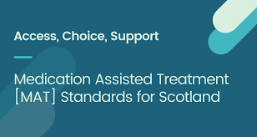

National Policy
2018
2021
2019
Notes:
National Policy that threads throughout all the work we do this is created to improve outcomes for people.
We help trickle the policy down to our communities through funding of services, supporting and creating governed mechanisms/groups for partnership working which includes operational work plans where partners work together to improve outcomes that have been taken from the above strategies as well as Scottish Government Drivers such as the National Mission, Residential Rehab Fund and the Whole Family Approach. We are also responsive to need
A current example of work is around Cocaine - its wider spread emergence across East Ayrshire has sparked the creation of a multi disciplinary working group to focus on key Harm Reduction messages for our community members created with the support NHS AA, those with Lived Experience, Service Providers (public and thread sector) and Public Health to name but a few the group has recently formed on request of partners and community members to focus on this specific area and provide key messages to members of our community.
The ADP are the torch bearers for new and emerging Scottish Government work streams as well as analysing data and considering an East Ayrshire perspective which I will go into more in the slide below we also actively seek the support of our community members which I will again go into further on in the presentation.

Slide 3
Local Policy
“East Ayrshire is a place with strong, safe and vibrant communities where everyone has a good quality of life and access to opportunities, choices and high quality services which are sustainable, accessible and meet people’s needs.”
Healthier
Safer
Wealthier
Notes:
We also take our lead from Local Policy which is known locally as the EA HSCP Community Plan which the ADP will align their new EA ADP Strategy whilst being cognisant to National Policy
The Lived Experience Panel – now review all the work of the ADP before it goes live, the lived experience panel is made up of members with LE, Mental Health conditions, Family Members of and creates a level of scrutiny and screening from a local community member perspective to tell us if we are getting it right or adjustments are required.
The emergence and support from the LEP has halted some of our work, produced more relevant work and helped the ADP partners consider things from a different point of view.
After working with a partner from psychology on a RECOVERY PATHWAY the pathway was presented to the LEP they all agreed it wasn’t fit for purpose – the LEP will now redesign the RECOVERY PATHWAY (aimed at those who have never accessed services before and don’t know how to go about it in the first instance) so it is much more user friendly and using the appropriate language for the client group we are aiming at. The learning here is ……. Engage with the LEP in the process at its beginning.

Slide 4
Stark Outcomes
‘The extent to which individuals within and across families are affected by another family member’s substance use – with survey respondents reporting on average 11 other people being affected by an individual’s substance use,’ Ask The Family - 2022
Drug related deaths
2019 | 2020 | 2021 | 2022
41 | 36 | 38 | 30
Alcohol related deaths
2019 | 2020 | 2021 | 2022
31 | 23 | 30 | 28
Notes:
What does this slide tell us – not only has a person lost their life but they have family members and loved ones grieving at home if we consider for every life lost there is at least 11 people directly affected – the ADP considering this are working on a Test of Change called Early Help for parents and children affected by alcohol and drug use. When we consider this on a Personal Outcome Basis we must consider each and every person within the home rather than working in silos i.e. Young People’s team helps the Young People and Adult Services team helps the Adults and never the tween shall meet – this is a stimulating piece of work that includes system change work and will improve whole family outcomes and therefore individual outcomes – the whole family will recover together and Young Persons services and Adult Services will work closer together.

Slide 5
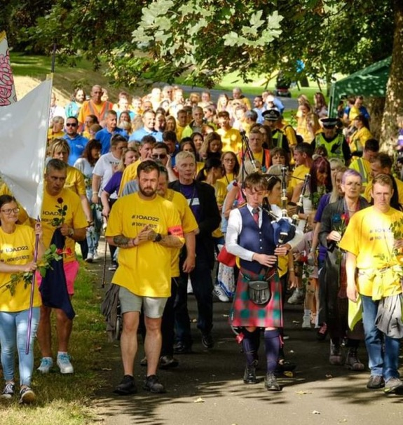
Services and Supports
Notes:
You said We Did – There was a hunger for recovery based infrastructure led and ran by those with lived experience for those with lived experience as well as peers who could perform the role of an outreach worker and ‘chap a door’ to check on a person’s wellbeing encouraging them back into a protective measure (support service or system). Therefore the Hub was created for those in recovery by those in recovery supported by the ADP and all ists partners it is now a thriving Hub in the centre of East Ayrshire with Spokes in the peripheral areas such as Auchinleck and Cumnock.
There was real disconnect between NHS Addictions in EA and the Recovery Hub after discussions both understood and recognised the merit of working together and in EA we created a one stop shop known as RADAR Rapid Access to Drug and Alcohol Recovery merging NHS Addictions, We are With You, EA Advocacy Service, Ayrshire Council on Alcohol and now the added value of being able to contact a Peer to ‘chap a door’ or vice versa if a concern is raised from the peer for example missed appointments.
Using this good example of a service aimed at improving Personal Outcomes – EA Recovery Hub and Spokes ran by those with Lived Experience for those with Living and Lived Experience to thrive within can provide – Volunteering (4 levels), Training, a Recovery College, support Groups, Meditation, space for Fellowships, SMART Recovery, Recovery Rocks (music group), Woman’s Thrive (women only community group), mens time (men only community group), Yoga and Qi Gong all based at improving personal outcomes for those who take part.
The above two examples show a holistic approach to personal choice alcohol and drug recovery.

Slide 6
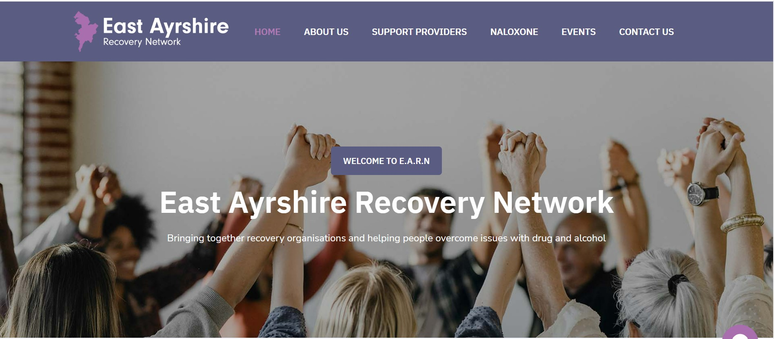
East Ayrshire Recovery Network (EARN)
Notes:
Another example of good outcomes - EARN all sectors working together as equals to improve personal outcomes for people they also have their own website which is the go to for any one touched by alcohol and drug use wanting to know what support and different type of support is available to them. Be it listening to a EA Recovery Podcast, attending a daily support group, advice for family members or taking that leap to contact a service for the first time it can all be found on this site.
The EARN provides Choice Access Support and all members work together as a Recovery Orientated System of Care across housing, justice, health, alcohol and drug service providers, training providers, those with lived experience, lived experience employees, DWP and Police Scotland (not an exhaustible list) to share news, and connect on new and emerging streams of work whilst reducing the incidence of silo’d working.

Slide 7
Thinking Differently Team
East Ayrshire Health and Social Care Partnership’s Strategic Plan and Vision sets out a model of engagement and participation with people who use our services that recognise human rights approach of choice, self-determination and partnership. This is a culture and approach that requires consistent practice across the Partnership.
Notes:
The Thinking Differently team within EA - our ADP has an aspiration to work with the team and further align their vision with ours due to the apparent parallels which I hope my presentation has shown.

Slide 8

What Matters to You
WHAT MATTERS TO YOU
Notes:
Next steps –
What are the priorities of the people who are being supported? Links to GIRFE !!
More collaboration
Whole Family Approach that brings about System Change
Whats working -
Trauma Advisory Board and Lead Officer supported by NHS Trauma Lead – training across Public and Third Sector to improve the service users experience of support from a more understanding and compassionate workforce
STIGMA post reducing barriers to accessing services encouraging community members to seek support in some cases people who have never accessed support before, Stigma Roadshows currently under way.
Public Awareness and compassion based events (IOAD Walk, Recovery Month, Recovery Walk, Women’s Recovery Month)
Active Communications Campaign (STV, West FM, PODCASTS)
Lived Experience Panel supporting, informing and challenging the work of ADP Partners
Improved Partnership working between public and third sector realising each others strengths I.E. RADAR Rapid Access to Drug and Alcohol Recovery One Stop Shop and the Recovery Hub and RES a Recovery Service also based in the heart of East Ayrshire
RADAR combines NHS Addictions, Advocacy Services, Ayrshire Council on Alcohol, We Are With You together in one place to roll out the MAT Standards –choice, access, support reducing multiple appointments and phone calls and ensuring before harm reduction, medical interventions, psychosocial interventions, advocacy support inclusive of ORT Choice, Housing Support and Benefit support is all available in the one office by a MDT working together to improve personal outcomes for the people and their families using the service.

Slide 9
Personal Outcomes Improve
Seeking Help
Increased Choice
Responsive services
Recovering
Human Rights
Community connections
Thriving
Increased Recovery Capital
Better outcomes
A joined up journey
A community
that understands
and cares

