Slide 1


Anne Leitch
Value Based Health & Care Programme Lead
Polly Windsor
Value Based Health & Care Senior Policy Advisor
Julia Mackel
Principal Lead
NES Quality
Improvement Team
Personal Outcomes Network
05/12/2023
@realisticmed
www.realisticmedicine.scot
Notes:
Thank you so much for inviting us to present at todays forum, throughout the presentation we will focus on key themes:
Some of the challenges linked to health and social care
Introduction to Realistic Medicine and VBH&C and why it matters
How we can support people to practise Realistic Medicine and VBH&C
Hopefully by the end of the session you will have a better understanding of how Realistic Medicine and VBH&C can help us achieve our shared goals and ultimately improve outcomes for the people we care for

Slide 2

SLIDO

Slide 3
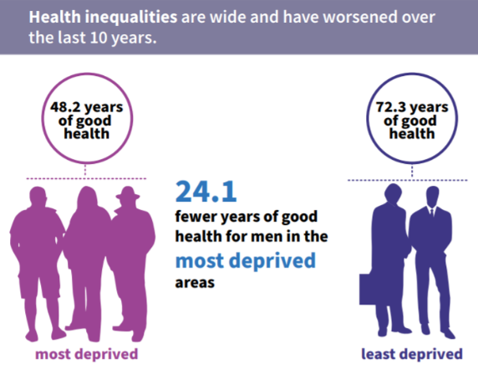
The Big Challenges for Health and Care
Health inequalities;
Changes in demography;
A mismatch between demand and need;
The relentless increase in the intensity of clinical practice.
PHS
Notes:
As you can see from this slide , our health and care system continues to face significant challenges:
We see widening health inequalities, as this image from Public Health Scotland shows vividly.
We know about Changes in demography - not just an ageing population, but also the fact that our life expectancy is relatively poor in Scotland and has not improved since 2012;
There’s a mismatch between demand for services and need, as we will see, with some people receiving too much care, and some too little.
And we face a relentless increase in the intensity of clinical practice
But we are not alone –these are challenges faced across the World.

Slide 4
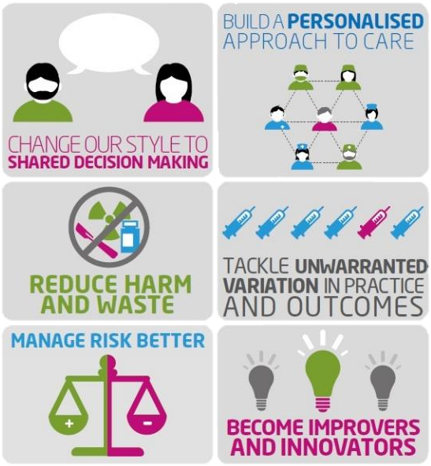

With
We Can…
Notes:
By practising Realistic Medicine, we will address many of the challenges we face, now and in the future. But what is Realistic Medicine?
Realistic medicine puts the person receiving health and social care at the centre of decisions made about their care. It encourages health and care colleagues to find out what matters most to people. Realistic Medicine recognises that a one size fits all approach to health and social care is not the most effective path for people or the NHS.
The six key principles of Realistic Medicine are set out on screen:
(i) Changing our style to shared decision-making. – we must promote more meaningful conversations that ensure people have a say in decisions about the care they receive.
(ii) Building a personalised approach to care. - We must support people to make informed choices about their treatment and care, considering what matters most to them as an individual.
(iii) Reducing harm and waste. We know that the overuse of treatment and investigation can cause harm to people. By reducing this harm and waste we can provide healthcare people really value.
(iv) Tackling unwarranted variation in practice and outcomes. Unwarranted variation is variation that cannot be explained by explicit individual need or population preferences.
(v) Managing risk better. – Involves health and care professionals being more comfortable with not following guidelines in every situation – every person is different and sometimes they will not benefit from what the guidelines are telling us we should do. Ensuring people are fully informed and consent to treatment is a particularly important component of managing risk better
(vi) We should also continue to improve and innovate. We need to foster an environment that supports innovation in healthcare delivery.

Slide 5
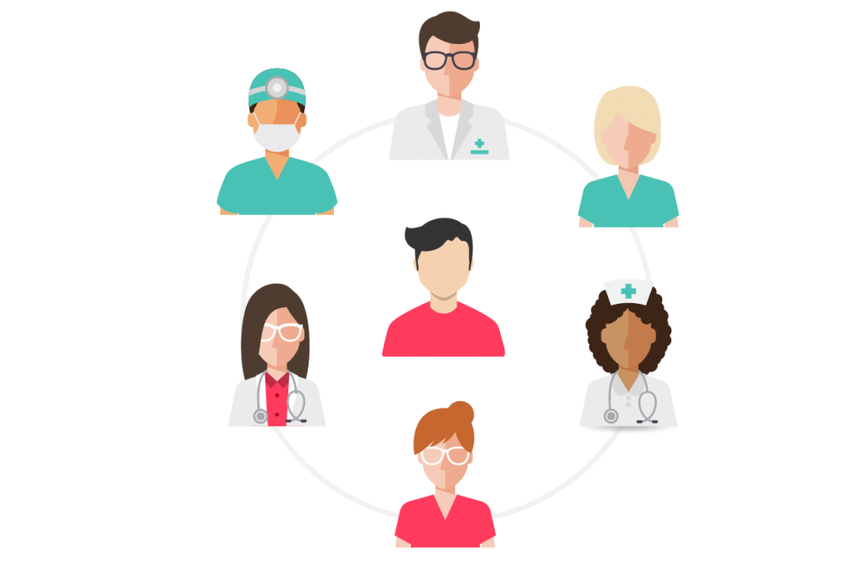
For Reflection
How can I help embed the principles of Realistic Medicine in my role?
Notes:
Before I talk to each principle of Realistic Medicine in more detail, I’d like you to consider this question throughout: How can I help embed the principles of Realistic Medicine in my role?

Slide 6

Shared Decision Making
‘‘Variability is the law of life, and as no two faces are the same, so no two bodies are alike, and no two individuals react alike and behave alike under the abnormal conditions which we know as disease.” William Osler (1849-1919)
Notes:
Promoting shared decision making is a key priority within the Realistic Medicine programme.
This is a great quote from Osler, frequently described as the Father of Modern Medicine. It sums up beautifully the reason why we need to build a more personalised approach to care. His greatest influence on medicine was to insist that we learn from seeing and talking to patients. His best-known saying was "Listen to your patient, he is telling you the diagnosis“
Shared decision-making is the key to delivering care that people really value. Realistic Medicine is not about failing to offer treatments. It is about supporting people using healthcare services, and their families, to feel empowered to discuss their treatment.
A move away from the “Doctor knows best” approach to shared decision making between patients and professionals requires more meaningful discussions about the treatment options available as well as their risks and benefits.
Research has shown that we tend to choose less treatment, and also more conservative treatment, when all the risks and benefits of various treatment options are fully explained to us.
When there has not been a full discussion of our preferences, or what truly matters to us has not been discussed, we are less likely to comply with a prescription, or regret a procedure, increasing harm and waste. As waiting lists grow, the need for personalised and value-based health and care is stronger than ever.

Slide 7
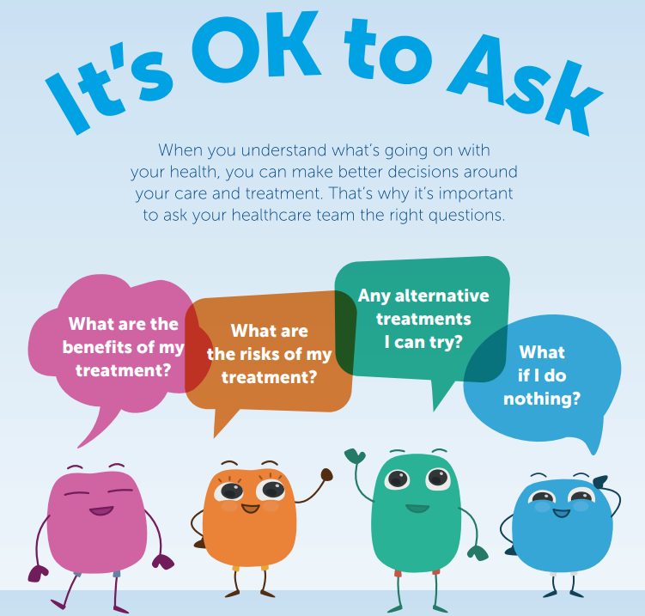
Notes:
We are also acting on the recommendations of a Citizen’s Jury on shared decision making, held in Scotland. The Jury told us we need to let people know that it ok for them to ask their health and care professionals questions about heir treatment and care.
In response, we supported NHS 24 to develop a campaign to raise public awareness. - What is the one thing we are saying?
“It’s Ok to ask.”
The questions we want people to ask are
• What are the benefits of my treatment?
• What are the risks?
• Are there other alternative treatments I can try?
• What if I do nothing?
Knowing the right questions to ask can make all the difference in helping people make an informed choice about the treatment and care that’s right for them.

Slide 8

A Personalised approach to care
Working to understand what really matters to people, patients,
and their families, and building trust to create a better experience of health and care for all
Notes:
Healthcare professionals must support patients to make informed choices about their treatment and care, considering what matters most to them as individuals. Personalised approach to care is about asking, listening and understanding “what matters to you”. When patients are fully engaged with their health care decisions, it can greatly improve their outcomes. In summary this approach ensures that the people who use our services are at the centre of everything we do.

Slide 9
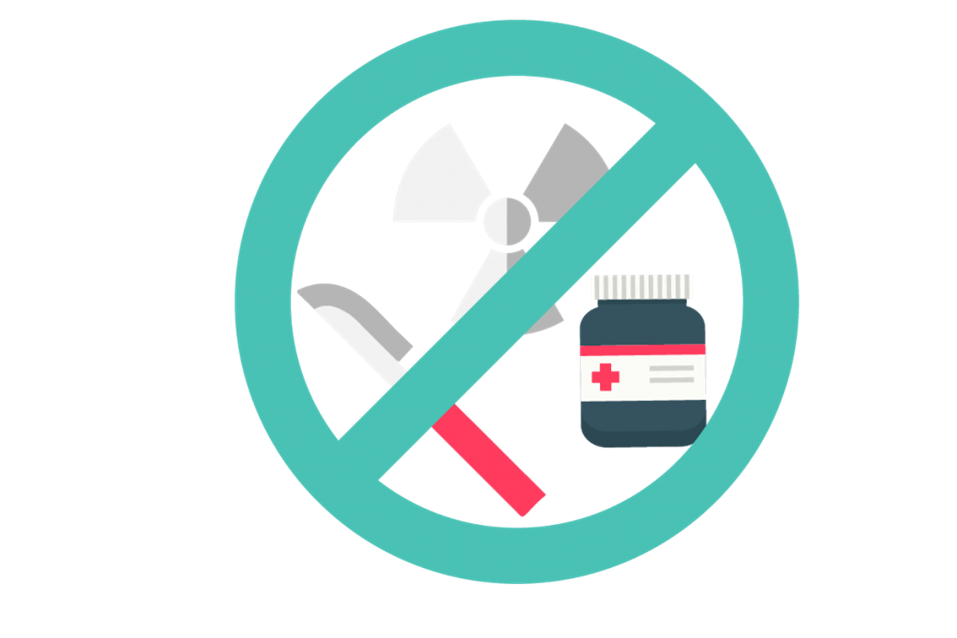
Reduce Harm and Waste
Making the best use of our precious health and care resources, and providing better care and outcomes for the people we care for.
Notes:
Sadly the Organisation of Economic Cooperation and Development (OECD) estimate that up to 20% of the care we are providing has no impact. We know that if people are fully involved in decisions about their care, they choose less treatment, or more conservative treatment. They are also far more likely to value the treatment they choose. This further reduces waste and potential harm.
We know that all health and care has potential to cause harm, for example, exposure to radiation from imaging, risks from procedures, and side effects from medication. Over-investigation and overtreatment may not only cause harm to the people we care for, but they also waste our precious healthcare resources.
Realistic Medicine ask us to responding to the twin threats of harm and waste by focusing on the concept of value which Polly will explain in her presentation.

Slide 10

Reducing Unwarranted Variation
Variation in healthcare provision that cannot be explained by need, or by explicit patient or population preferences
Notes:
Another of the main aims of Realistic Medicine is to tackle variation in healthcare provision that cannot be explained by need, or by explicit patient or population preferences.
Variation occurs for a number of reasons. There will always be some variation because health systems are complex and the population has differing needs. However, some variation cannot be explained by the characteristics of the people being treated, or their geographical setting. This is called unwarranted variation.
Recognising unwarranted variation is of vital importance because it will help to deliver value based healthcare by identifying:
Under-use of higher value interventions (i.e. under treatment)
Over-use of interventions which should be used less frequently or could cause harm

Slide 11

Become Innovators and Improvers
Supporting a culture of innovation and improvement to help make the changes that need to happen
Notes:
Realistic Medicine also asks us to become improvers and innovators…

Slide 12

NHS Near Me
Reduces the number of people attending NHS and social care premises;
Enables people to attend appointments from wherever they choose
Reduces travel and minimises time taken off work or school, for patients and their families;
Helps address environmental imperatives: by reducing travel, improving move towards net zero.
Notes:
During the pandemic we have utilised technology to assist in delivering patient care remotely. As many of you will know, Near Me video consulting is transforming the way people are accessing health and care services. Near Me is used in every NHS Board area in Scotland, and is now being expanded to care services. One patient feedback that they felt this was a great option as it was much more efficient, and they weren’t exhausted from the journey, their mind was fully engaged on the conversation and the dialogue was much more constructive – this can have a real positive outcome for people.

Slide 13

Spreading The Message of Realistic Medicine
An animation series introducing the principles of Realistic Medicine can be found at RealisticMedicine.Scot
Notes:
If you head to our website, Realistic Medicine.Scot, you will be met by a series of animations that introduce Realistic Medicine and the principles I’ve described here today. I’d encourage you all to have a watch
These animations have been designed to introduce Realistic Medicine and clearly explain each of the 6 principles and promote conversations. We hope they are a valuable resource for you and your teams, and we would ask you to share them widely throughout your networks.

Slide 14
With
We Can…
Notes:
Today I’ve spoken about some of the big challenges our health and care system is facing
We can all recognise that more of the same – to continue doing things the way we’ve always done them - is not the answer.
And it is by practising realistic medicine that we will deliver value based health and care – better value for patients and better value for our system.
I hope you have a better understanding of Realistic Medicine and I hope that I’ve encouraged you to consider what you can do to promote and practise it.
I will hand over to my colleague Polly who will provide an introduction and overview to VBH&C.
Thanks

Slide 15

“achieving outcomes that matter to people”
Notes:
The primary focus of our health and care system is achieving the outcomes that matter to people. We must focus on their wellbeing both in health and during illness, targeting our interventions on what really makes a difference, and operating in a sustainable way at the lowest possible cost. This is the essence of value-based health and care.

Slide 16
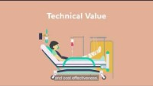
Notes:
We produced a number of animations last year on RM and VBH&C with NES and will play through the VBH&C one now and it gives a good initial overview of what we mean by it.

Slide 17
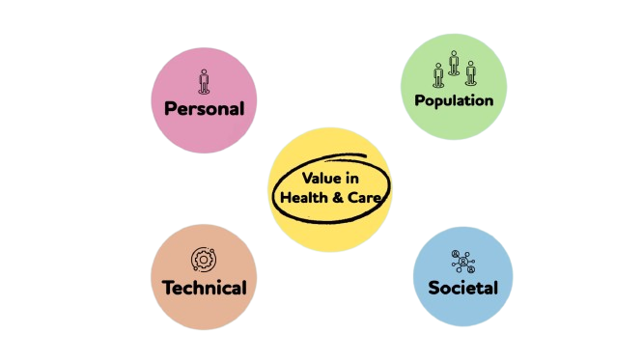
What is Value Based Health & Care?
Value = Outcomes
Cost
Notes:
So traditionally Value can be thought of as outcomes over costs – does it provide good or the right outcomes for the cost.
However, as you saw in the animation, in VBH&C value is considered to have 4 different elements – Personal, population, technical and societal.
So as an example, for some people, although the recommended course of treatment for them might be something quite intense, for example chemotherapy, for the individual, that might not give them high personal value as it would impact their quality of life for the time they have left. You can see that in this example, practicing RM – with shared decision making and a more personalized approach to care, would help to highlight that personal value element.
All the aspects of value need to be considered in decision making about treatment. It’s not about cost-cutting or efficiencies but instead is about using the resources we have in the best way possible for the people we care for and the whole population.
VBH&C therefore has the potential to have a positive impact on patients, but also on those practicing it, as it helps increase job satisfaction and improve wellbeing when people feel a more personal connection and that they are delivering real value.
In many cases, VBH&C does not need to mean huge changes but instead thinking about things differently

Slide 18
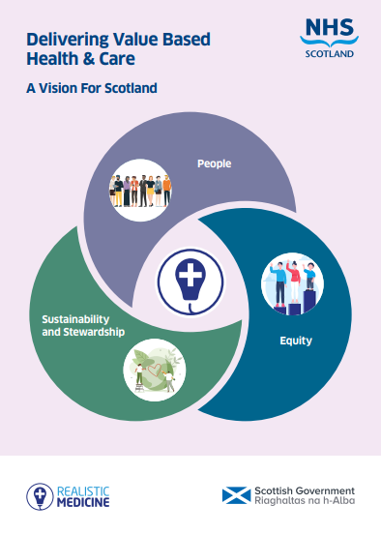
Definition
Value Based Health & Care delivers better outcomes and experiences for the people we care for through the equitable, sustainable, appropriate and transparent use of available resources.
Vision
By 2030 all health and care professionals will be supported to deliver Value Based Health & Care. This will achieve the outcomes that matter to people and a more sustainable system.
Notes:
In December 2022 we published “delivery VBH&C – a vision for Scotland” to outline what VBH&C can mean for Scotland.
Following extensive stakeholder engagement, we settled on the following definition and vision ----
Setting the tone and language around this has been very important to ensure we are inclusive and moving in the right direction
You will notice that we talk about people rather than patients – based on feedback in stakeholder workshops, and inclusive to both health and social care

Slide 19
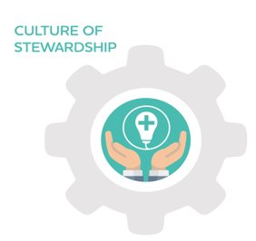
Creating a working environment in which a culture of stewardship can flourish is vital if we wish to deliver more sustainable care as well as help tackle the climate emergency.
Notes:
As also set out in the vision, VBH&C aims to foster a culture of stewardship where health and care colleagues take responsibility for the resources they use, practise shared decision making and tackle unwarranted variation, in order to provide better value care. Health and care colleagues aspire to deliver care that people really value and if we can support them to deliver it, we expect to increase job satisfaction as well as deliver better outcomes
We believe that practising RM re-connects healthcare practitioners to their purpose - delivering personalised, person-centred care which matters to people
VBH&C encourages and supports health and care colleagues to take responsibility and be accountable for increasing value in health and care. This requires working in partnership with people, communities and health and care systems to disinvest from low value care and focus on high value care. VBH&C seeks to foster and promote a culture of stewardship across health and care.

Slide 20
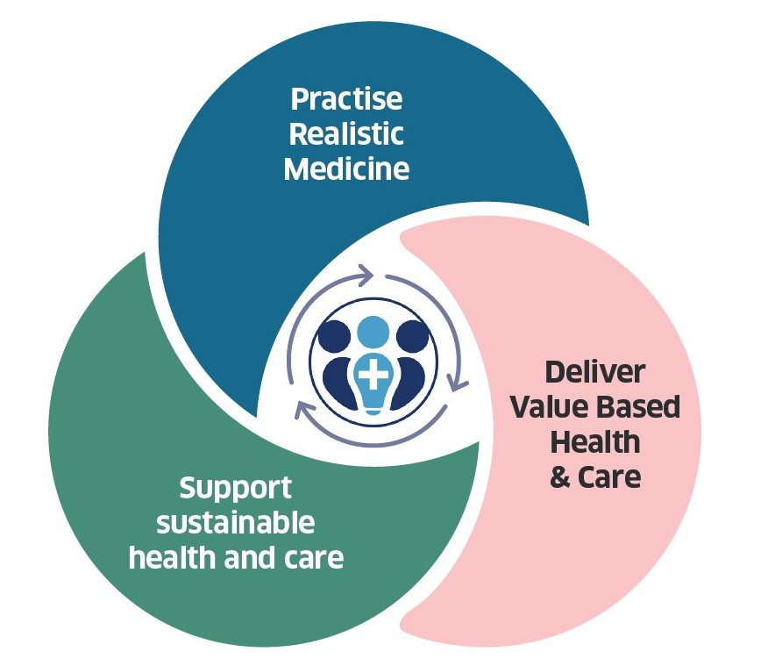
Notes:
Then on the right is a visual representation of our key message that by practicing rm you will deliver vbh&c and this will support a more sustainable health and care system

Slide 21
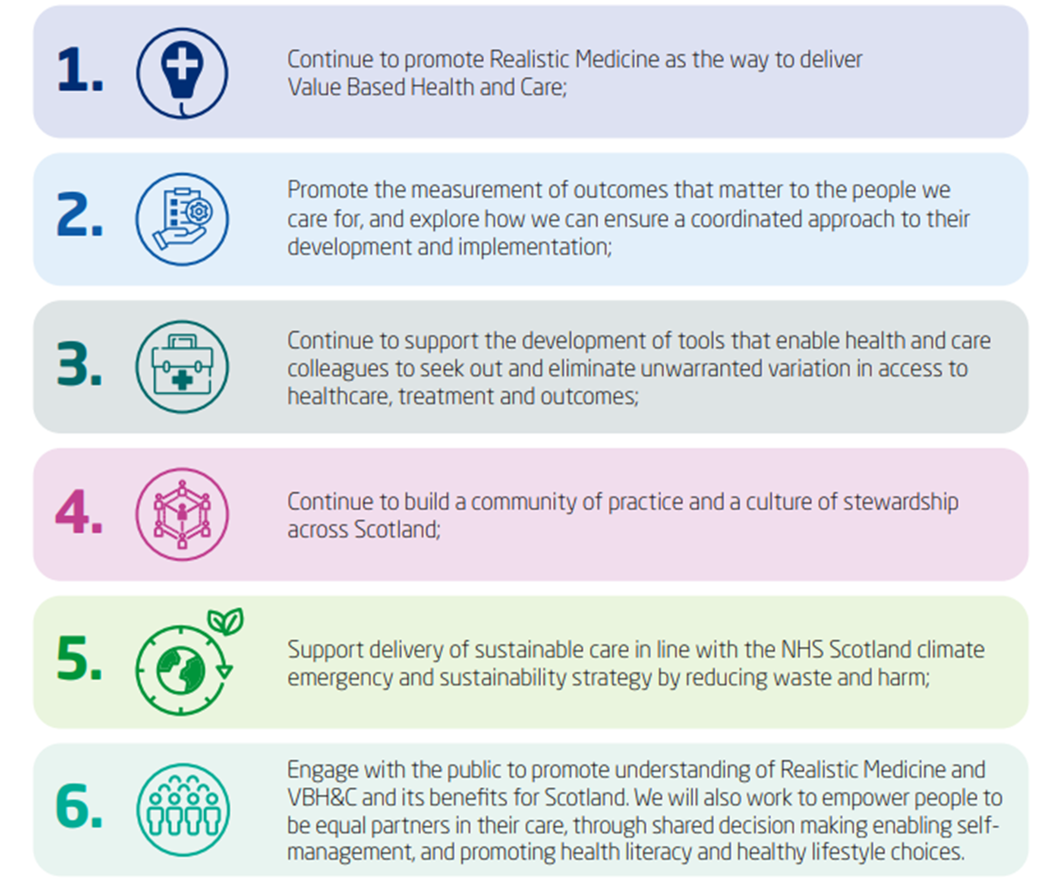
6 High Level Commitments
Notes:
Following the theory of VBH&C, within the vision we made 6 high level commitments which are shown here.
They focus on promoting RM, measurement of outcomes, supporting tools to eliminate UV, building a CoP and CofS, sustainable care and engaging with the public.
These commitments guide us on where our focus will be in delivering VBH&C according to the vision for 2030

Slide 22
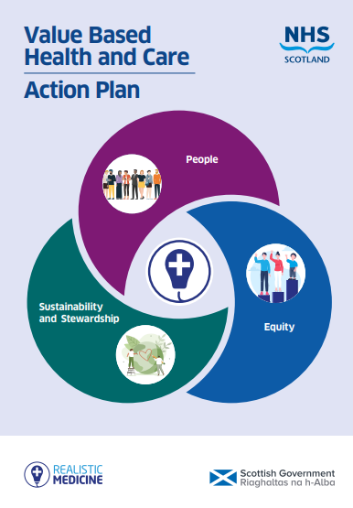
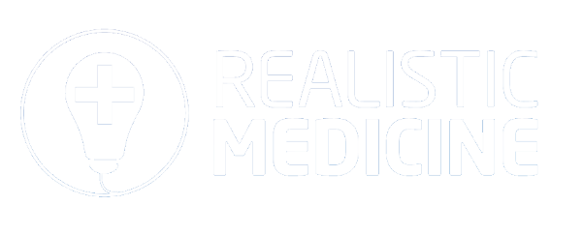
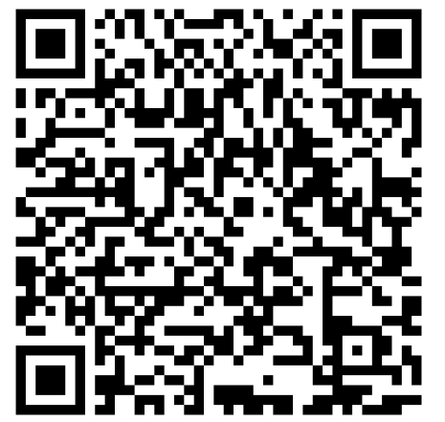
From vision…
…to action
@realisticmed
www.realisticmedicine.scot
Notes:
Following the vision we were delighted to publish the action plan for Value Based Health and Care on 4th October this year, which alongside the CMOs annual reports is our guiding light for implementation of Realistic Medicine, and the delivery of Value Based Health and Care in Scotland.
Extensive stakeholder collaboration has helped shape this action plan, we’ve worked with policy teams and stakeholders across Scotland, including a wide variety of health and care professionals to agree the actions in this plan.
It is important to note that the plan is focused primarily and appropriately on supporting health and care professionals – no matter their role to practise Realistic Medicine and deliver value based health and care across our health and care system.

Slide 23
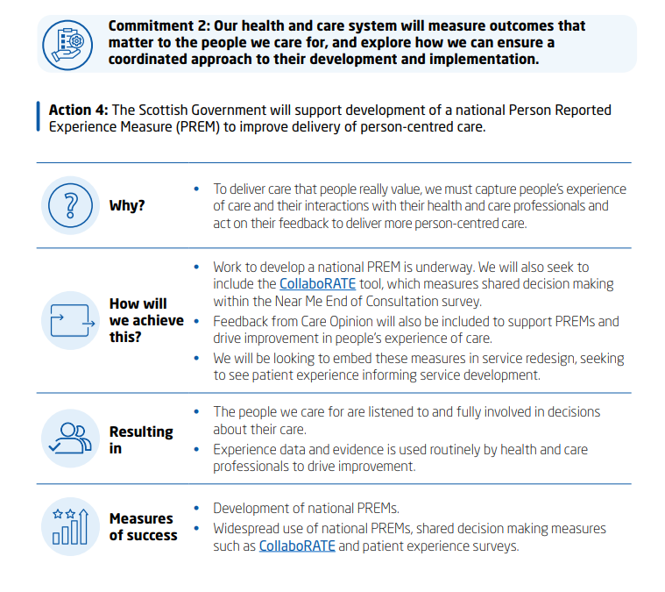
Commitment 2: Our health and care system will
measure outcomes that matter to the people we care for and explore how we can ensure a coordinated approach to their development and implementation.
Notes:
In particular, I wanted to highlight the actions in the plan that are most closely related to outcomes – actions 4 and 5
They stem from commitment 2 ----
You might not be able to read all of that but it’s just to give an idea of how we have formatted our thinking in the plan. Each action has a why, how will we achieve this, resulting in and measures of success outlined – we intend for this to keep us accountable to what we will expect to see as a result of our actions and how they will contribute towards achieving the vision
Action 4 focuses on the development of a PREM for Scotland – this work is already happening with our colleagues in the PCC team in SG and aims to create a way to understand people’s experiences of care across the system – to understand if we are delivering what’s needed

Slide 24
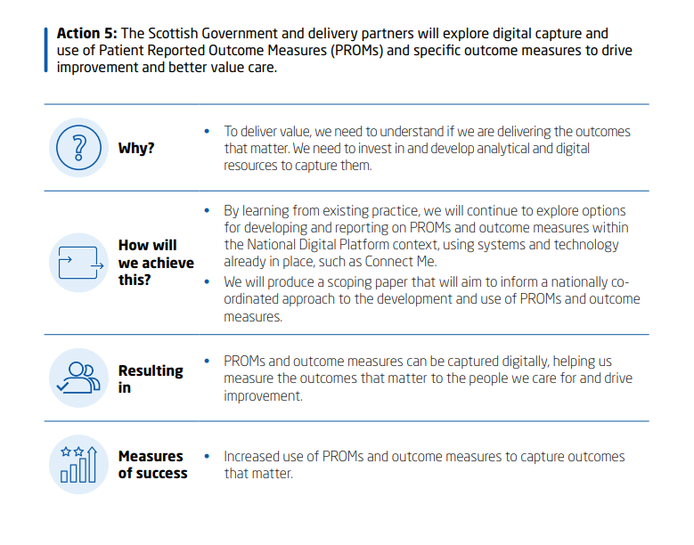
Commitment 2: Our health and care system will
measure outcomes that matter to the people we care for and explore how we can ensure a coordinated approach to their development and implementation.
Notes:
Action 5 commits us to explore the digital capture of PROMs and outcome measures to drive improvement and better value care. We know that there is a lot of work already happening across the country on this and so as a first step we are aiming to understand the current landscape and ensure we don’t duplicate work which is currently happening

Slide 25
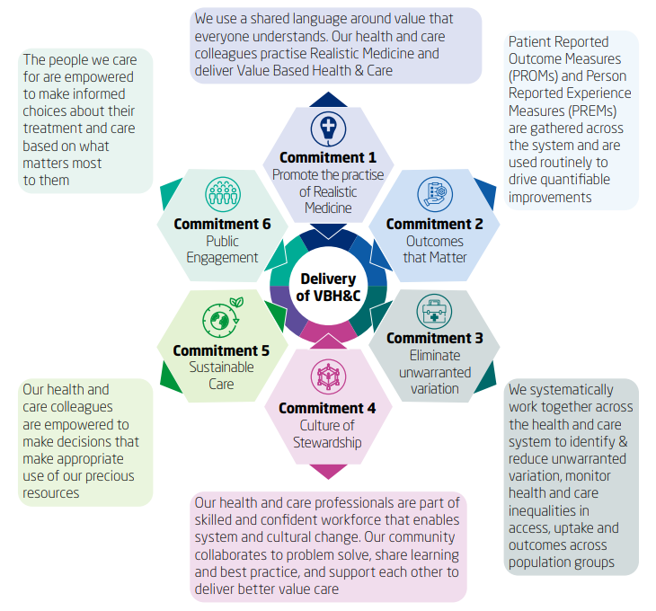
What does success look like?
Notes:
When forming the action plan it was important to us that it included a clear description of what success would look like, following the vision we’ve set out
Throughout the plan, each action has measures of success outlined, however, this image articulates what we would expect to see at a higher level if we are successful in achieving each commitment
There’s a lot of words on the slight but as a quick overview – you can see the importance of the following aspects:
A shared language
Whole system working
A supported and collaborative workforce
Empowered staff and patients

Slide 26
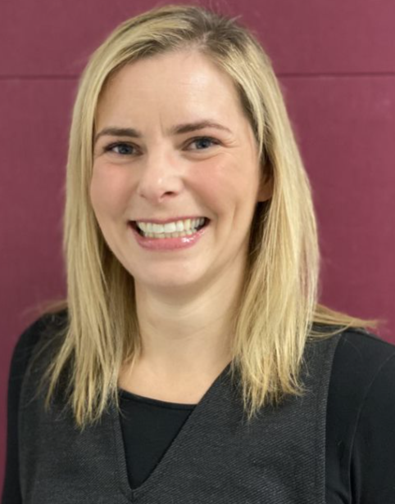
Personal Outcomes Network
Julia Mackel
Principal Lead
NES Quality Improvement Team
Julia.Mackel@nhs.scot

Slide 27
NES Supports RM and VBH&C by:
Developing and designing education and resources for staff
Co-design
Test
Accessibility

Slide 28
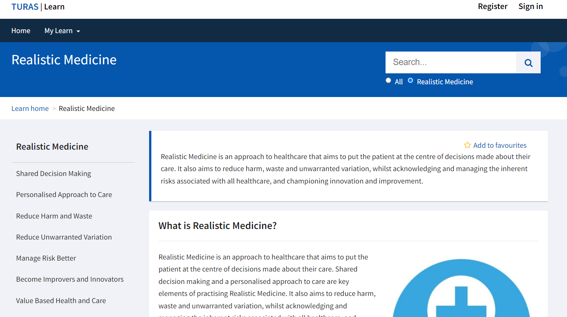
https://learn.nes.nhs.scot/18350/realistic-medicine

Slide 29
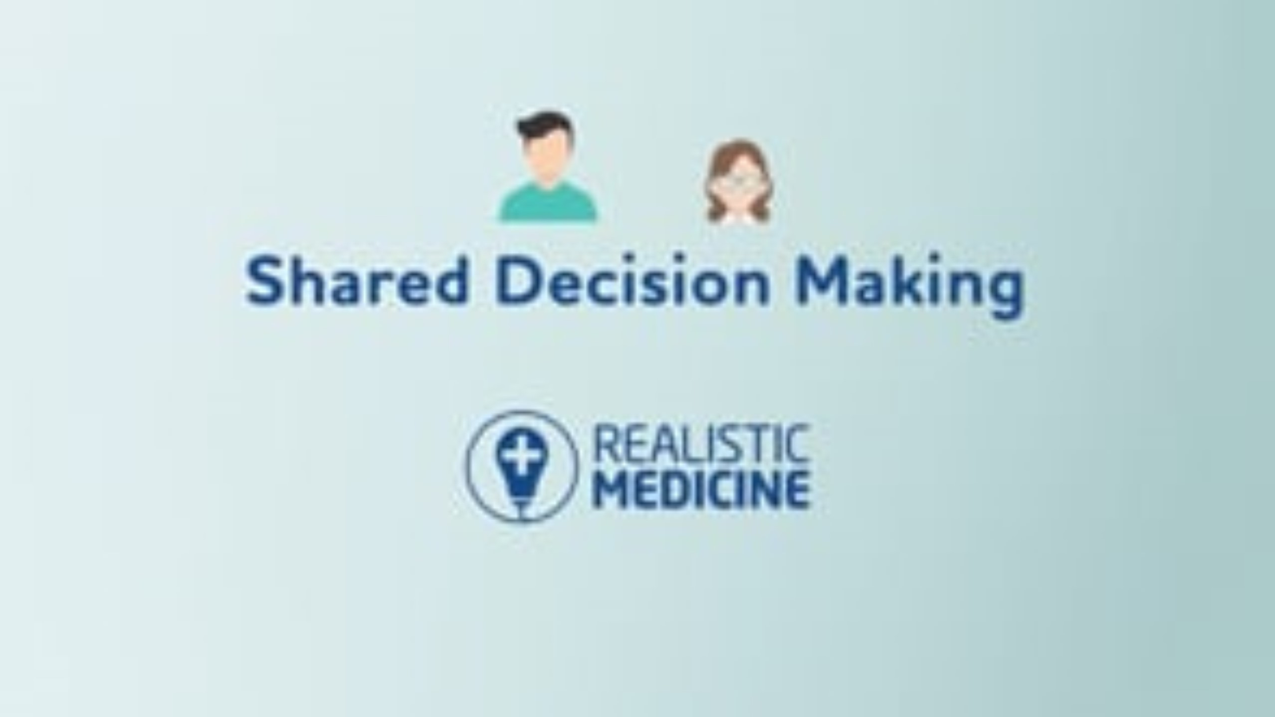

Slide 30
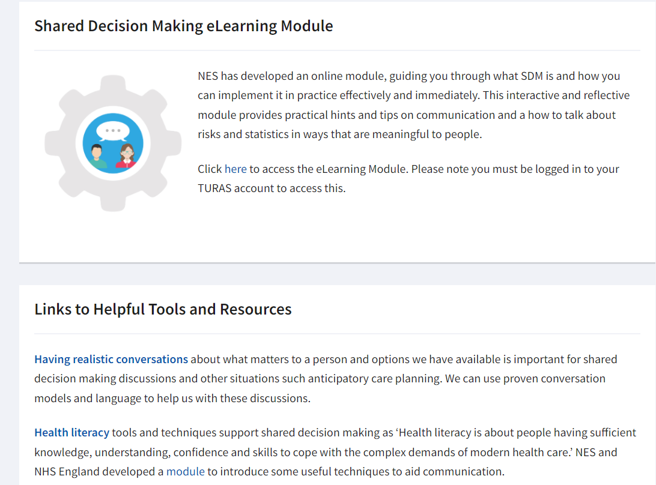

Slide 31
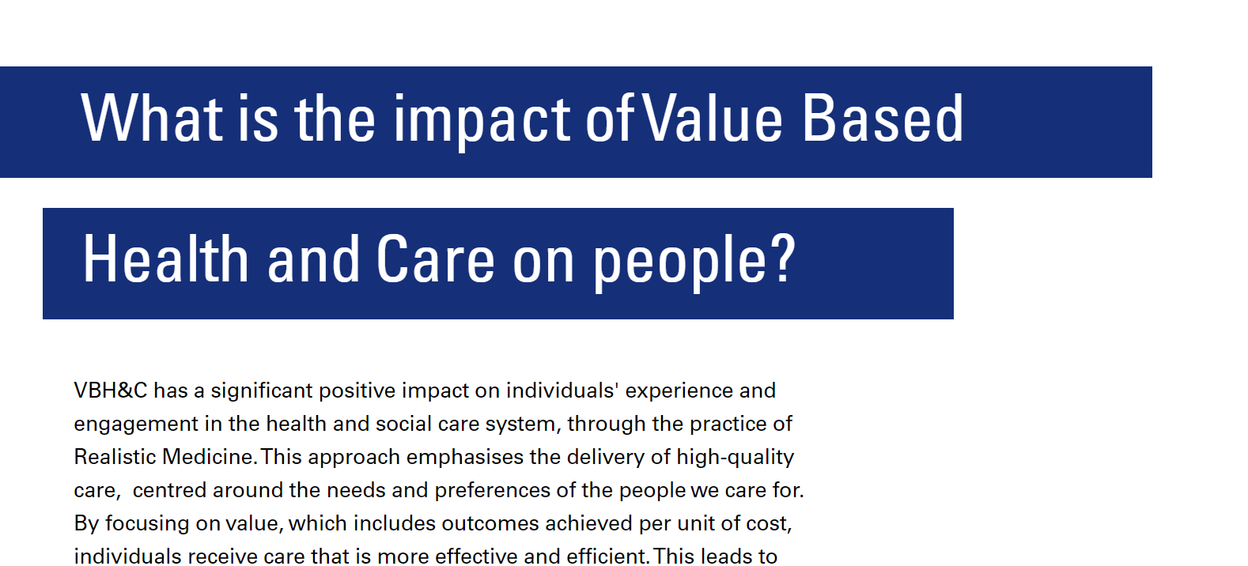
Outcomes that Matter

Slide 32


